Slide 1
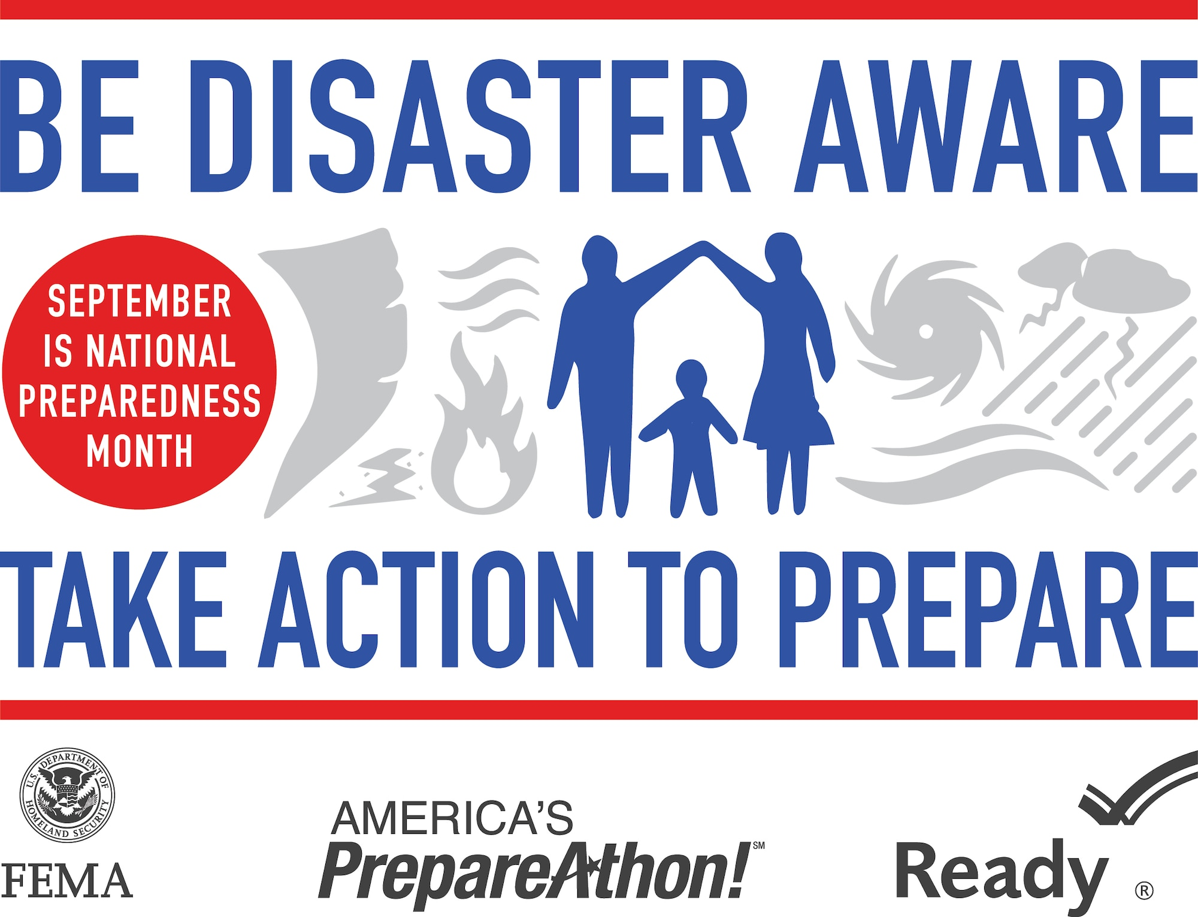
Preparedness Basics for Emergency Responders Ensuring your family is safe so you can go to work and save your community
Notes:
www.securethegrid.com

Slide 2
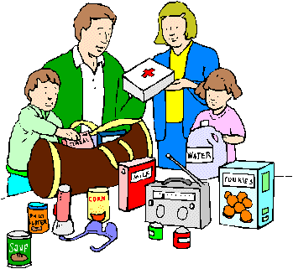
Preparedness goal
To educate and encourage emergency responders to become better prepared for disasters, so they can go to work and save their communities.
Notes:
Preparedness Links:
FEMA Ready - https://www.ready.gov/
The American Civil Defense Association - https://tacda.org/

Slide 3
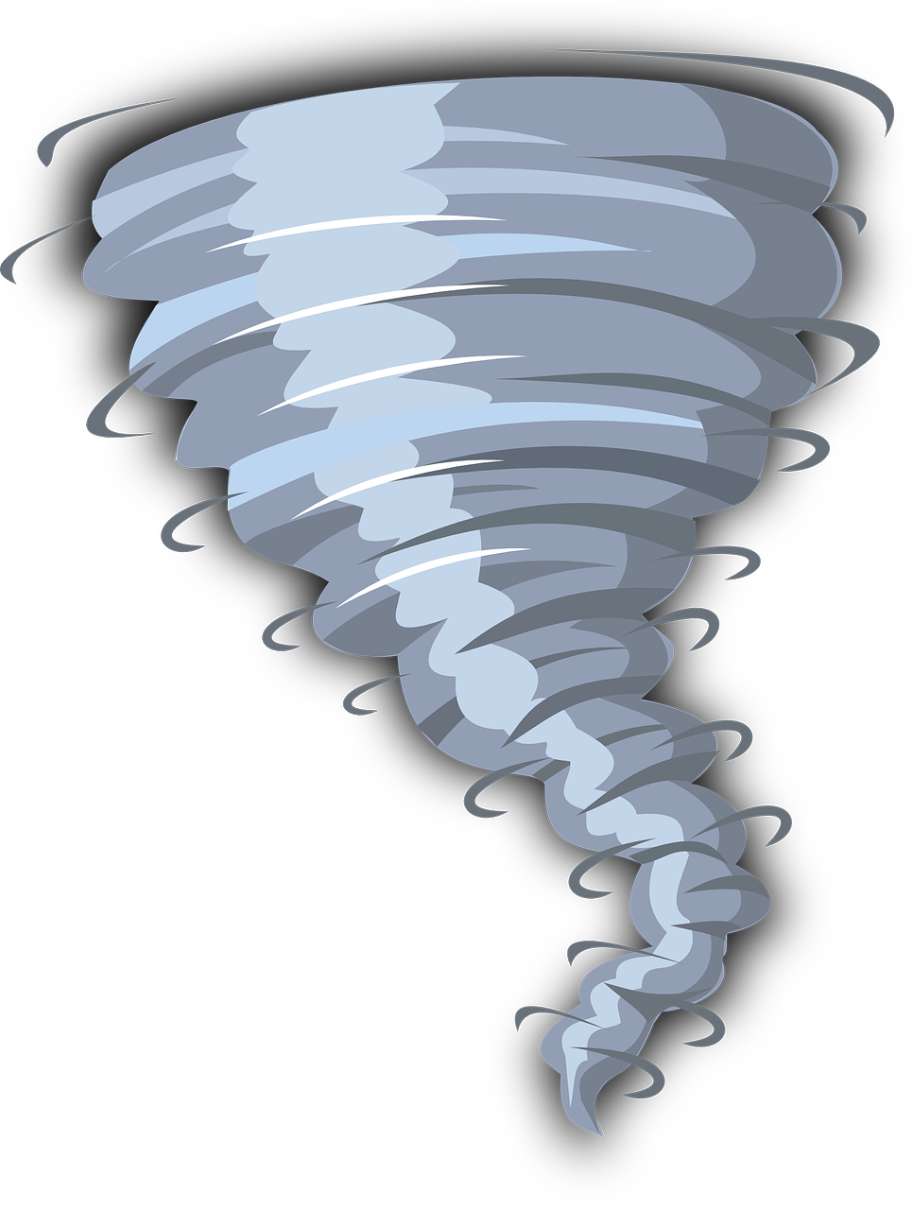
Disaster Preparedness
Being prepared for disasters can reduce fear, anxiety, and stress that result from disasters.
Being prepared can also reduce the physical impact of disasters.
It can mean the difference between life and death.
Notes:
It doesn’t hurt to be prepared for emergencies and disasters. And it doesn’t have to cost a lot, nor take a lot of time. All it takes, is the decision to do so and the determination to make it happen.
Being prepared can mean the difference between life and death for you and your loved ones. It can lessen the impacts to your life and can make it easier to recover.
The biggest hurdle we have is to convince ourselves that disasters can happen to any of us. Whenever you talk to a disaster victim, one of their first statements is – “ I can’t believe this happened to me.”
Well, it did. And it can happen to you too.
As the Boy Scout Motto says – “Be Prepared!”

Slide 4
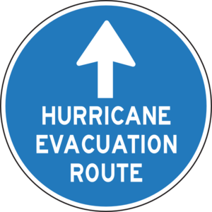
Definitions
Hazard: A dangerous event that has the potential to lead to an emergency or disaster.
Examples - disease outbreaks, wildfires, floods, tropical storms, tornadoes, earthquakes, winter storms, cyber-attacks, hazardous materials releases, energy outages, terrorism or war.
Notes:
Hazard: A dangerous event that has the potential to lead to an emergency or disaster. These can be natural or human caused and can include: disease outbreaks, wildfires, floods, tropical storms, tornadoes, earthquakes, winter storms, cyber-attacks, hazardous materials releases, energy outages, terrorism or war.
Some hazards are more likely to happen than others. The likelihood of a specific hazard is also dependent of the size and severity of the hazard. A one acre wildfire is far more likely to happen then a 100,000 acre wildfire.
On September 11, 2001, the United States was attacked by terrorists who caused more deaths then were lost at the attack on Pearl Harbor in 1941. Did we expect the attack on September 10, 2001?
Why couldn’t another major world power attack America’s power grid with a cyberattack tomorrow?

Slide 5
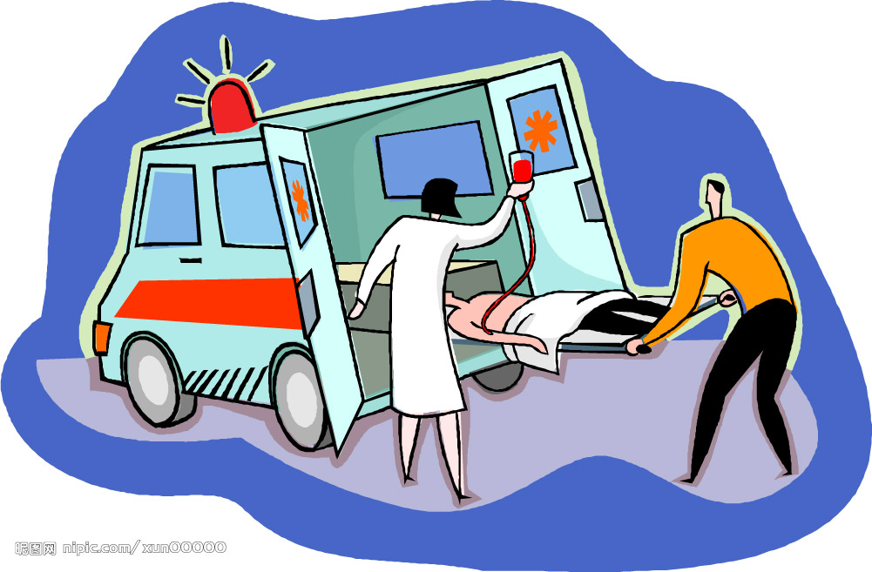
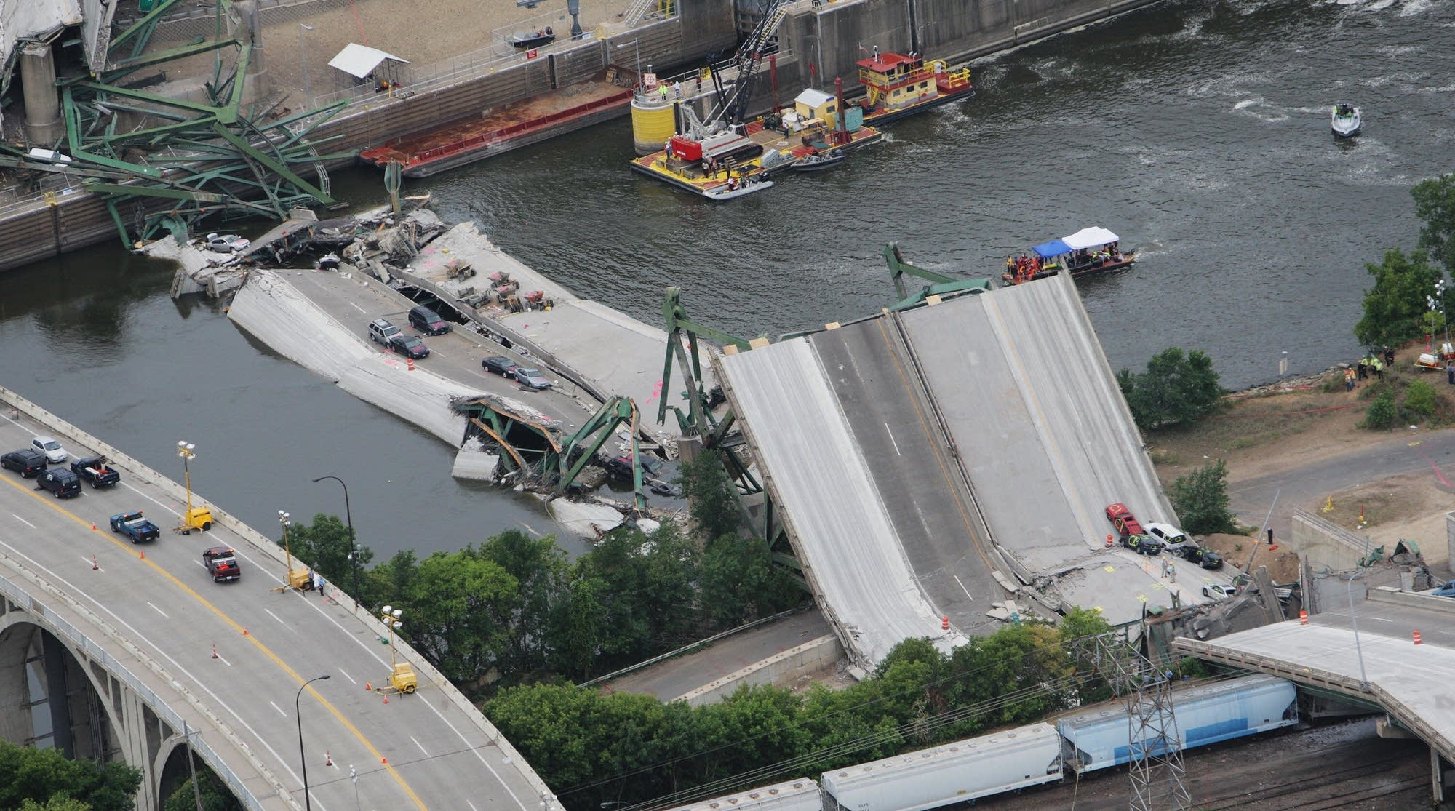
Definitions
Emergency: A dangerous event that normally can be managed at the local level.
Disaster: A dangerous event that causes significant human and economic loss and requires a crisis response beyond local resources.
Notes:
Disasters are distinguished from emergencies by the greater level of response required.
As an emergency responder, you may respond to emergencies multiple times every day.
A two-car accident is an example of an emergency. The Fire and Rescue Department and a Police Officer are dispatched. They deal with the emergency and move on.
A larger emergency may require assistance from another fire department or additional police officers.
In 2007, the I-35W Mississippi River bridge in Minneapolis, Minnesota collapsed, killing 13 people and injuring 145. This required a response from many surrounding communities, and the State and Federal governments. This was a disaster, not just an emergency.
Simply put, emergency responders are sized and equipped to handle routine emergencies. Fire and Rescue and Law Enforcement agencies are not size or prepared for disasters.

Slide 6
Definitions
Civil Defense The activities and measures undertaken to minimize the effects of hazards upon the civilian population; to deal with the immediate emergency conditions; and to effectuate emergency repairs and restoration of basic human needs.
It is a Community Self-Help Disaster Preparedness Program.
Notes:
The activities and measures undertaken to minimize the effects of hazards upon the civilian population; to deal with the immediate emergency conditions; and to effectuate emergency repairs and restoration of basic human needs. Locally, the Civil Defense program is managed by the Emergency Management Agency and local volunteers. The volunteers provide personnel, under the direction of EMA, to support disaster logistics, mass care (sheltering and feeding), and communications.
Our Fire Departments, Ambulance Services and Local Law Enforcement Agencies are not staffed for a disasters, but for day-to-day emergencies. During region-wide disasters, mutual aid will probably not be available. State response agencies are also not staffed for disasters and may be overwhelmed with critical issues in major population centers.
The Federal government may take days or weeks to arrive and the only real response element they have is the military.
All disasters are local. Your local community is the only effective and timely disaster response and recovery resource. Community volunteers must be a part of the solution.

Slide 7
Definitions
Whole Community: Everyone in the community is a part of the local civil defense program. The local emergency manager cannot prepare a community by themselves.
Local government leaders, community organizations, businesses and every citizen must be a part of the solution.
Notes:
The Whole Community is a means by which residents, emergency management practitioners, emergency responders, organizational and community leaders, and government officials can collectively understand and assess the needs of their respective communities and determine the best ways to organize and strengthen their assets, capacities, and interests. By doing so, a more effective path to societal security and resilience is built.
Emergency Managers who work on their own to produce emergency plans and put these plans on the shelf in their office have not included the Whole Community. There is no buy in from anyone and the plans are worthless.
Every member of the Community needs to do their part for disaster preparedness. If you and your family are prepared to “weather the storm”; assist your neighbor with getting prepared and volunteer to help out the community during a disaster. Give input into the community’s emergency plans and preparations. If you are a member of a community organization, like the Boy or Girl Scouts, Rotary, Masons, VFW or American Legion, Lion’s Club, Snowmobile/ATV Club, and many others, consider having your organization take on a disaster role.

Slide 8
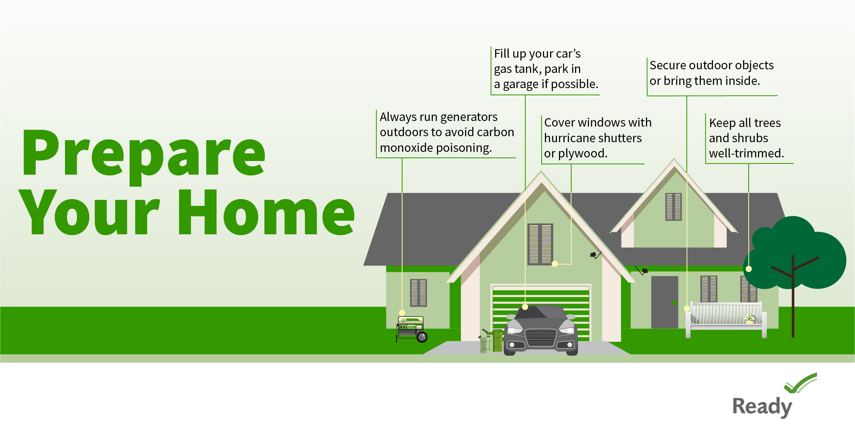
Definitions
Disaster Preparedness (DP): Measures taken by individuals to prepare for and reduce the effects of disasters.
Notes:
We make our communities disaster-resilient when all our community members are prepared for the impacts of disasters.
Hazards like floods and power outages don’t have to result in “disaster events”. If we have built our drainage systems to resist storm water damage; if we have restricted construction in floodplains; if we have backup power systems in place; and no one is impacted by the hazard event – there’s no disaster.

Slide 9
Definitions
Emergency Management: The management function that coordinates disaster preparedness, response and recovery in order to help protect (defend) the civilian population
Notes:
Locally, this function is managed by county and municipal Emergency Management Agencies (EMA) and associated partners and emergency teams. They are supported with guidance and funds from state and federal emergency management.

Slide 10
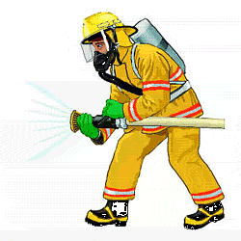
Local Emergencies
Structure Fires
Transportation Accidents
Flu
Small Wildfires
Annual Flooding
Thunderstorms
Winter Storms
Hazardous Material Releases
Notes:
This is by no means a complete list of all possible emergency that can occur in your community; however, they are the most likely emergencies that can happen on a day-to-day basis.
Flu season happens every year. There is a structure fire occurring on a regular basis. Springtime is both flood season and wildfire season. Car accidents can occur several times a day or a week. Fuel spills are common. In summer, we have regular thunderstorms and every winter we have several snowstorms.
Most of these emergencies are dealt with by our local law enforcement, fire protection and emergency medical services departments without too much trouble.

Slide 11
Local Emergencies
These hazards have short term impacts.
They can result in minor damages, neighborhood evacuations, and even some injuries and deaths.
They do not overwhelm our local public safety agencies, nor the long-term functioning of our communities.
Be prepared for emergencies, but simple steps are usually all that are necessary.
Notes:
All of these hazards can have localized and short-term impacts. They can result in damages to roads, lost work time, neighborhood evacuations, and even some injuries and deaths. However, for the most part, they do not totally overwhelm our public safety and emergency management agencies, nor the long-term functioning of our communities. You need to be prepared for emergencies, but simple steps are usually all that are necessary. Disasters on the other hand, which happened less often, can have severe long term societal impacts.
Examples include:
Ensure that you have smoke detectors in your house; that flammables are properly stored; electrical wires are not overloaded; that your family has a fire evacuation plan and has practiced it.
Go indoors when thunder roars. Drive safely and defensively. Get your flu shot.
These are all preparedness activities for day-to-day emergencies.

Slide 12
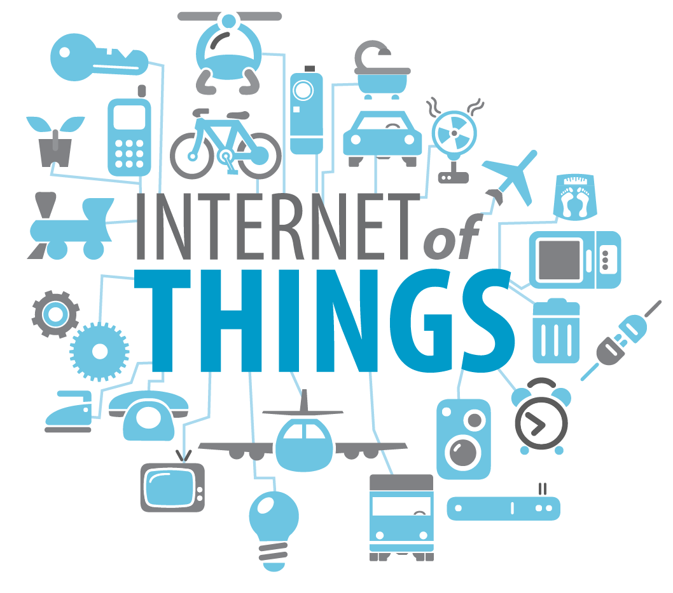
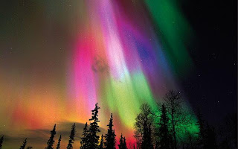
Major Disasters
Hurricanes/Tropical Storms
Earthquakes
Large scale wildfires
Severe Winter & Ice Storms
Extreme Solar Storm
Cyber Attack on Critical Infrastructure
Anything causing a Large-Scale, Long Term Power Outage
Notes:
Fortunately, major disasters do not happen on a day-to-day basis. However, they can occur when you least expect it. This is where you can be prepared beforehand.
The East Coast can experience hurricanes and tropical storms. Storm surge along the coast, heavy rains and strong winds can cause a great deal of damage to our electrical distribution system, roadways, homes and businesses. Many areas can experience major earthquakes or monster tornadoes.
The same event that can cause northern lights (severe solar storm), if strong enough at the right location, can also cause major damage to our electrical transmission system. Large transformers can burn up – transformers that are not stockpiled, These transformers have to be built when needed (and can take 6-12 months to build).
A single nuclear device detonated high in the atmosphere will not cause damage to structures or hurt people on the ground, but an electromagnetic pulse from that detonation can fry all electronics for hundreds or thousands of miles.
Without electricity, there is no fuel distribution and everything requires fuel to work.

Slide 13
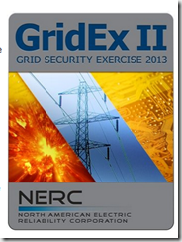
Disaster Impact
The one thing in common with all major hazards is they all can cause a long-term loss of electrical power.
Outages can cause a lack of fuel, food, water, heat and sanitation. Electronic financial transactions may cease. Businesses may not be able to function. Transportation and communications may stop.
Notes:
Whether the hazard is a earthquake, hurricane, windstorm, ice storm, solar storm, or cyber attack, a major impact will be the loss of commercial power.
Without power, most gas stations will not be able to pump gas and even if they do, they might not be resupplied.
Grocery stores will lose their produce and may also not be resupplied.
Banks and ATMs will not be able to process funds. Credit cards and debit cards will not process. Do you have a lot of cash on hand?
TV and radio stations could be down. Without fuel resupply, phones will stop working in a few days.
This sounds like a Hollywood disaster movie. It isn’t. Its Puerto Rico after Hurricane Maria.

Slide 14
What’s the chance?
25% chance that your home will be have a reportable home fire in 78 years.
Almost 100% chance that East Coast communities will experience a hurricane in 30 years.
Which is higher?
Notes:
Do you have home insurance? Why? How much do you pay each year for your home to have insurance coverage?
If you purchased your home in 2000, you may have spent at least $20,000 to $40,000 in home insurance premiums. Many have never had a fire in a home they have owned. Yet they still pay for insurance. Why? Because, if the unlikely were to happen and they did not have insurance, they could lose everything and their family would have no where to live. Though not likely to happen, the loss would be too great.
Being prepared is like a form of insurance. You hope you never have to use it, but if a disaster happens, you will be very glad that you did prepare.

Slide 15
So? I’ll just call 911
Public Safety is staffed to deal with day-to-day emergencies. They are not staffed to deal with disasters.
What is the emergency responder to resident population in your community?
If just 10% of you community population needs emergency services, can you handle it?
Notes:
During a disaster event, you might not be able to call 911, because the phone system could be inoperative. Even if the lines are up, there may be so many calls that you can’t get through. Even if you do get through, your local fire department and ambulance service will be so overwhelmed, they may not be able to help you.
If you live in a community with 150,000 residents and 10% need services – that’s 15,000 people in trouble. Most responses that more emergency responders then the number of people in need. For example, one car accident victim requires at least 2 EMTs, 4 firefighters, 2 police officers, an Emergency Room doctor and nurse and 1 dispatcher. That equals 11 public safety personnel for one victim. During a major disaster, it could take more responders then the number of people living in the community.
Disasters typically impact a large geographic area. Therefore, there will be no mutual aid.
And, emergency responders may also be impacted by the disaster, so staffing numbers may be even lower.

Slide 16
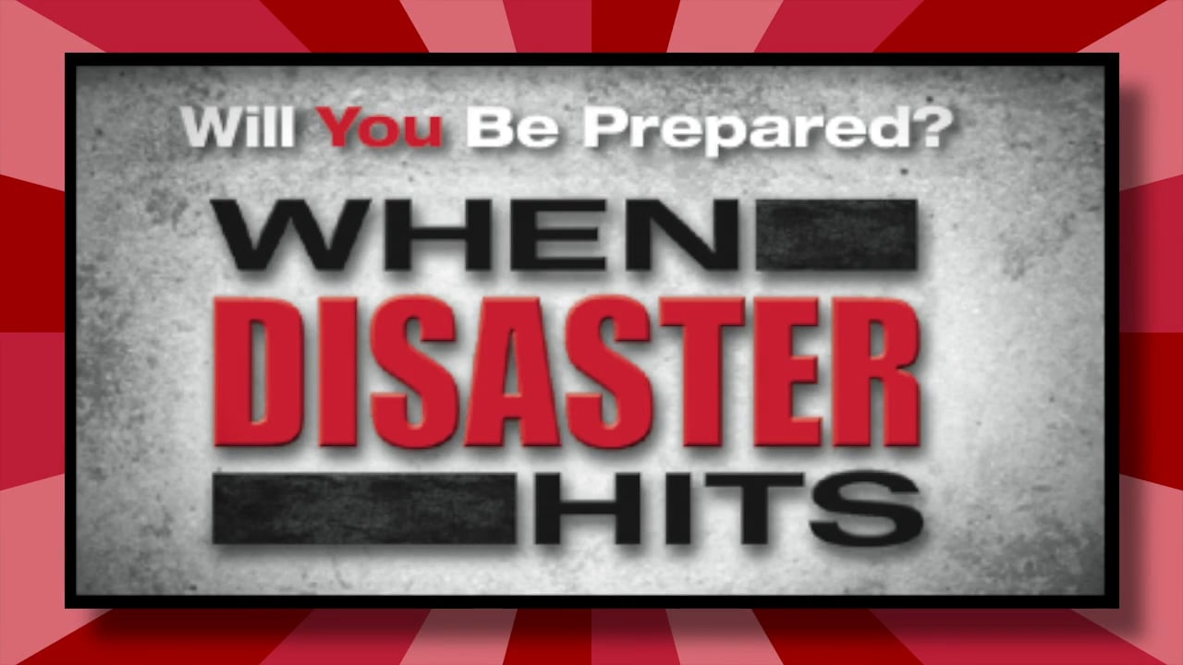
Disaster Preparedness and you
No matter what causes the disaster, be prepared to take care of yourself and your family –
Barely Ready – 3 days (recommendation by FEMA)
Basic Prepared – 14 days (minimum)
Better Prepared – 30 Days+
Best Prepared – 3 to 6 months
Notes:
FEMA recommends being prepared for three days following a disaster. Disasters are not resolved in three days and government is not responsive enough to be helping in three days. If you want you family to weather a disaster, you need to be prepared for much longer.
We recommend, at a minimum, to have on hand what you need for at least two weeks. One month is even better. Six months would be great!
During a major disaster, it could take weeks to months to fully recover. You must be prepared to take care of you and your family when the lights go out. Local government will also be “in the dark” and unlikely to do much (unless of course, many members of the Community are prepared and they come out to help). The State government will also be struggling to recover.
And if the Federal government can accomplish anything in months, it’s considered an “overnight success.”
Don’t expect the Calvary to be coming over the hill, unless you’re leading the charge.

Slide 17
Personal readiness
You can be prepared to take care of yourself for at least two weeks for around $400. Why wouldn't you. This is really cheap insurance.
And you don’t have to spend $400 all at once. Take 20 weeks at $20/week to prepare.
Notes:
For an investment of around $400 dollars, you can have the tools and supplies on hand that you would need to take care of your family for a week during a disaster that causes a power outage.
The rest of this class will give you some ideas for your own preparedness planning. Each family situation is different. There is no single plan that will work for everyone. We’ll give you the tools so that you can build your own plan.

Slide 18
So what should I do?
Clean Drinking Water
Non-perishable food
Staying Warm
Basic Sanitation
Medical Needs
Important Records
Finances
Backup Power
Plumbing Protection
Emergency Communications
Family Communications
Evacuations and Shelters
Protecting your Family
Checking up on others
Reporting for work so that you can recover and protect your community.
Notes:
These are the topics that will be discussed in the following pages.
The first activities are for personal preparedness. The last activities are what it might take to report to work so that you can help your community to recover.

Slide 19
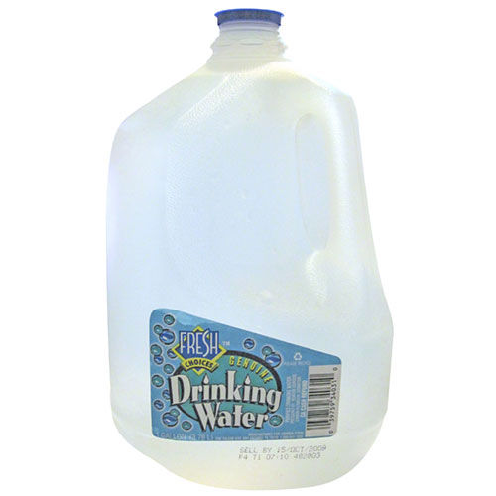
Clean Drinking Water
Plan on 1 gallon of water per person per day for at least 7 days. More is better.
Don’t forget water for your pets!
Purchase 1-2 gallons every week ($1/gallon) to build up a stockpile
Or you can store your water in thoroughly washed plastic, glass, containers.
Never use a container that has held toxic substances.
Store in a cool, dark place. Rotate water every 6 months.
Notes:
For a family of four, it would cost less then $30 (or taking the family out for pizza and drinks once) to stockpile enough water for four for one week. And you don’t have to do it all at once. Every time you go grocery shopping, pick up 2 gallons of water.
The great thing about a gallon of bottled water is you know its sanitary and it’s sealed. If you are really into prepping, you can purchase large capacity drums, do your own sanitizing, and tracking the expiration dates. But for the average family, pick up a few gallons each week.
Water stored for a long time goes stale. It can be freshened up and in a real bad emergency, you can drink stale water. What you really have to be careful of is water that gets bacteria in it.
This is where sanitizing your water is important.

Slide 20
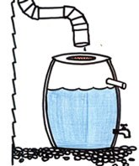
Emergency outdoor water sources
If you need to find water outside your home, you can use these sources. Be sure to purify the water before drinking it.
Rainwater
Streams, rivers and other moving bodies of water
Ponds and lakes
Natural springs
Avoid water with floating material, an odor or dark color.
Use saltwater only if you distill it first.
Notes:
Not all the water we need has to be fit for human consumption. Stale water can be used to boil vegetables. Non-potable water can be used for the toilet or watering the garden.
If you use water found outside your home, you will want to make sure it isn’t contaminated with chemicals. Also, use an old t-shirt, a strainer or a coffee filter to filter out any large organic materials.

Slide 21
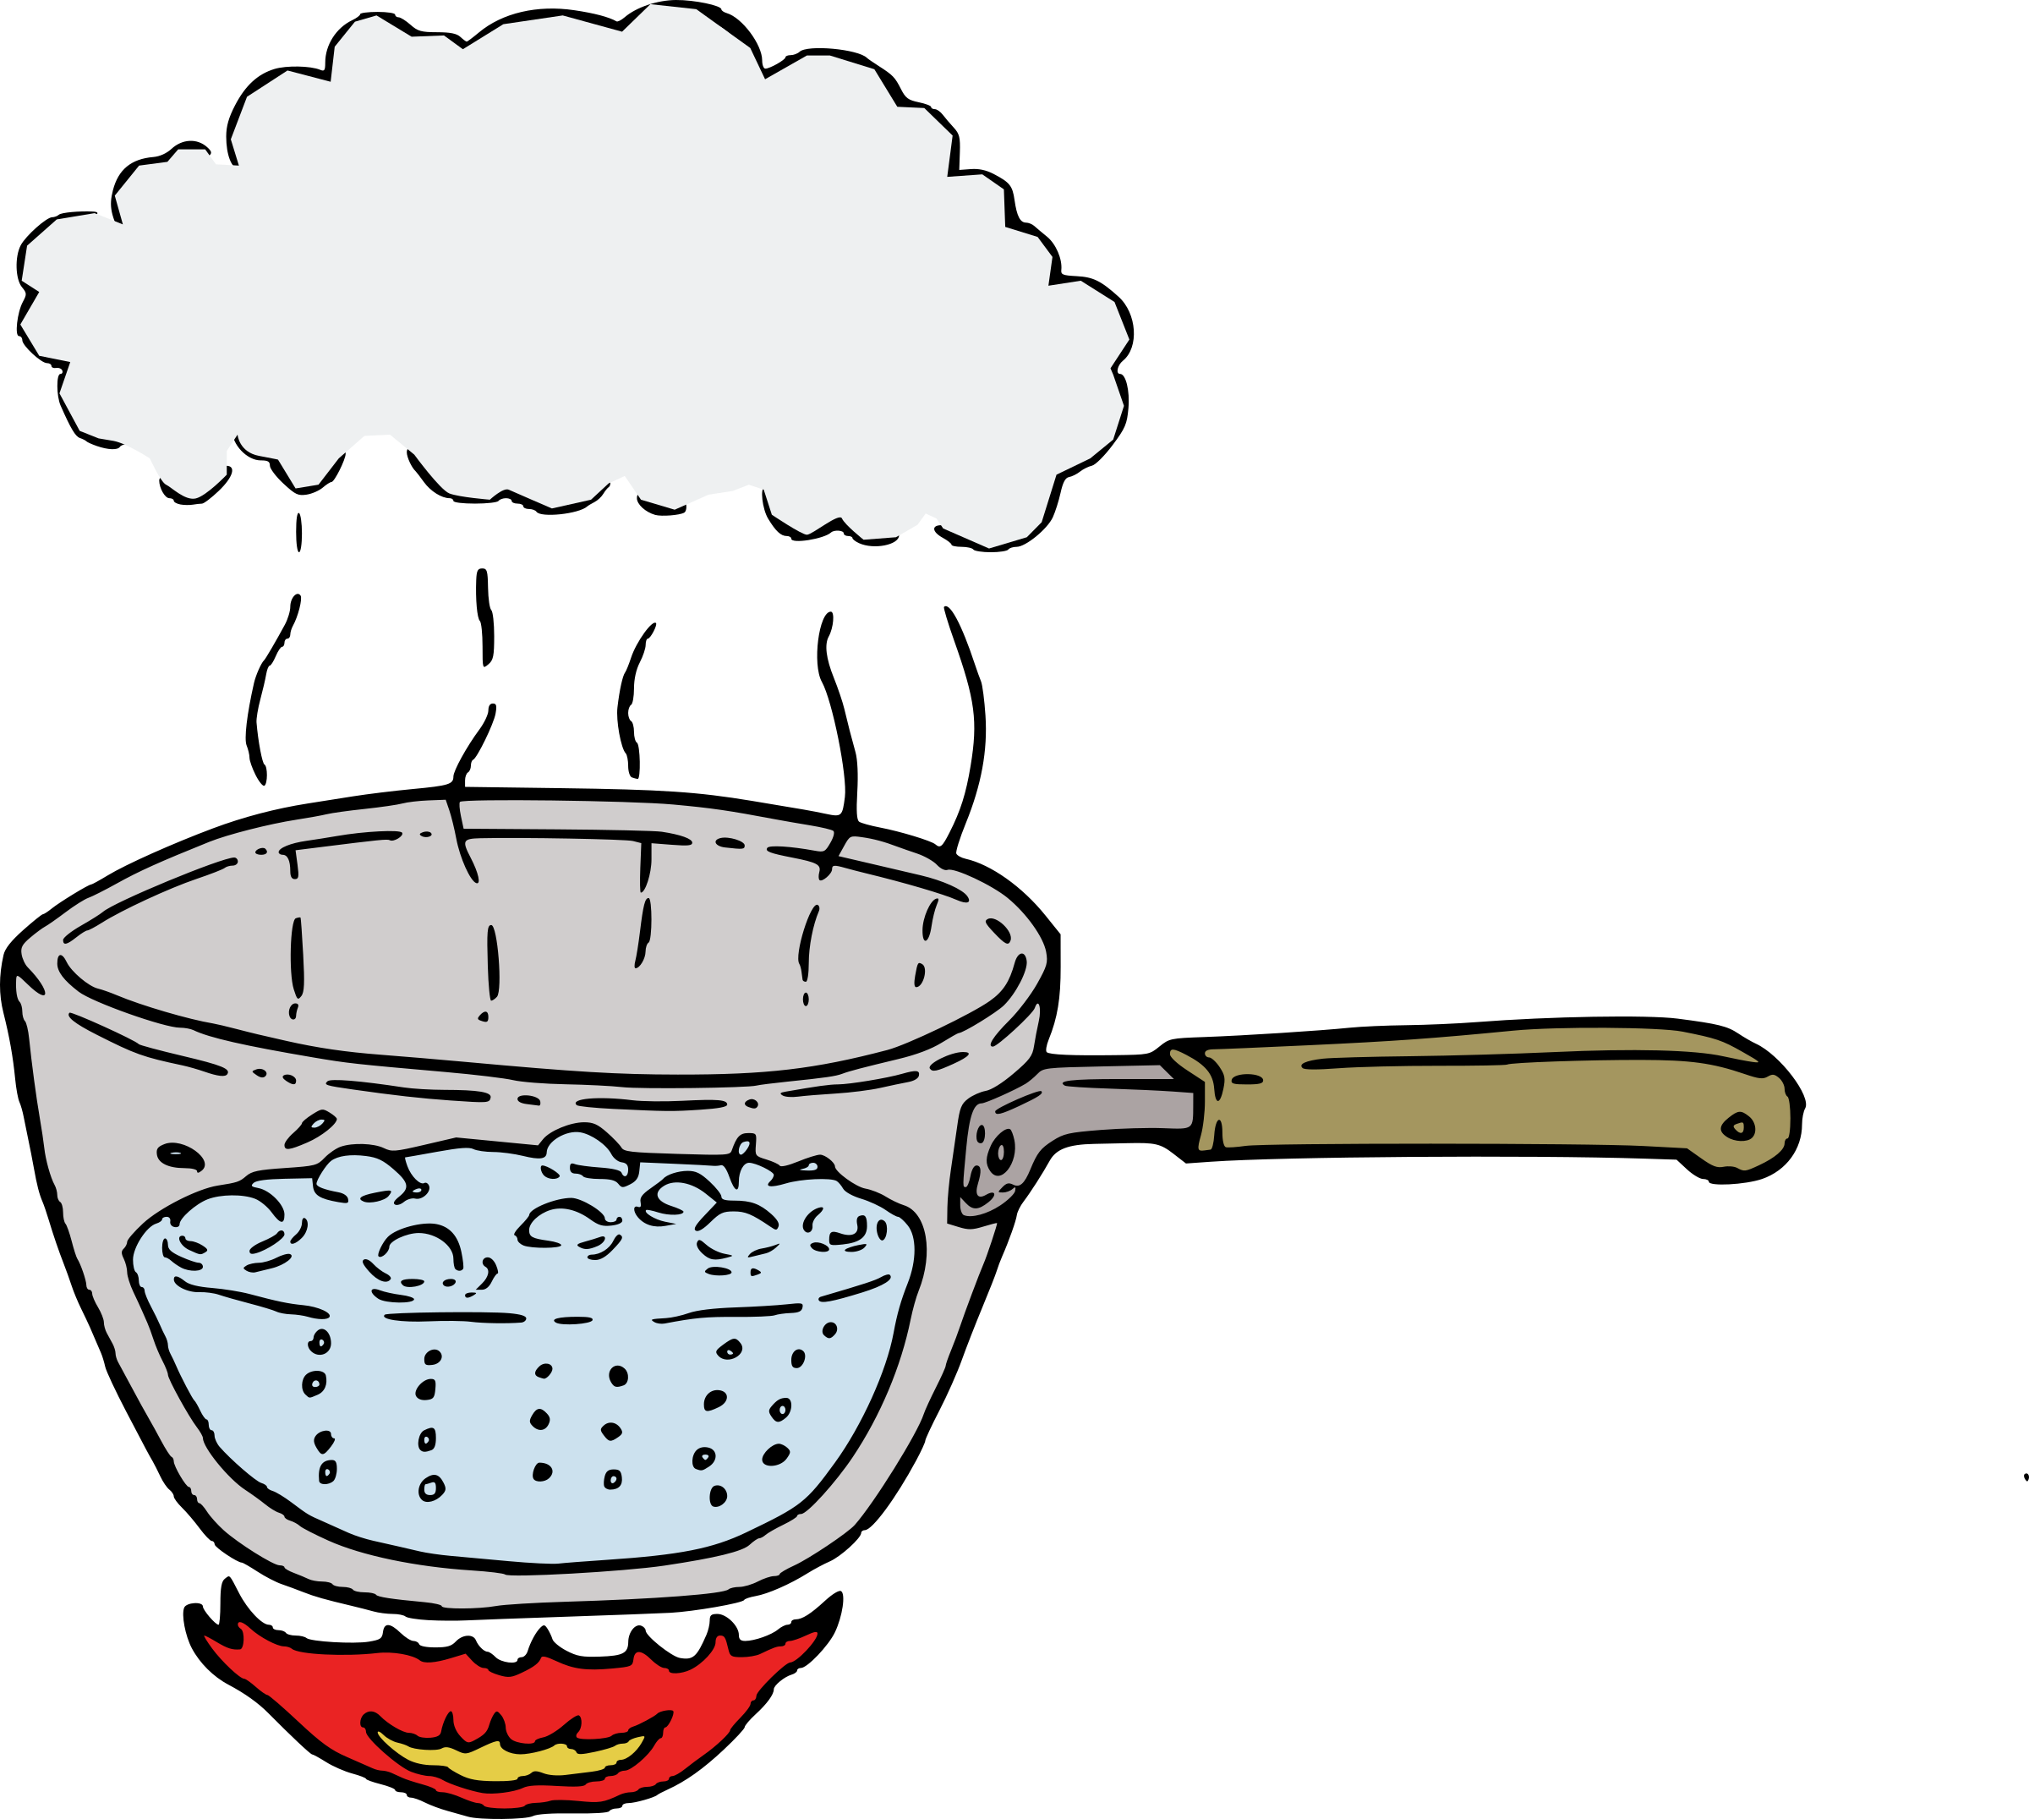
Purifying Water
BOILING.
Boiling is the safest method of purifying water.
However, it will not remove solids or chemicals.
Notes:
BOILING. Boiling is the safest method of purifying water. Bring water to a rolling boil for 3-5 minutes, keeping in mind that some water will evaporate. Let the water cool before drinking. Boiled water will taste better if you put oxygen back into it by pouring the water back and forth between two clean containers. This will also improve the taste of stored water.
Of course, you need a source of cooking that doesn’t require electricity. This could be an outdoor fireplace, a bar-b-que on the porch, or a woodstove.

Slide 22
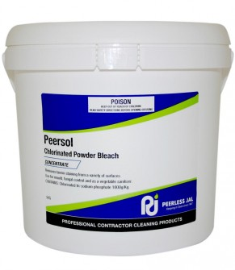
Purifying Water
DISINFECTION.
You can use household liquid bleach to kill microorganisms.
However, it will not remove solids and chemicals.
Notes:
DISINFECTION.
You can use household liquid bleach to kill microorganisms.
Use only regular household liquid bleach that contains 5.25 percent sodium hypochlorite. Do not use scented bleaches, color safe bleaches or bleaches with added cleaners.
Add 16 drops of bleach per gallon of water, stir and let stand for 30 minutes. If the water does not have a slight bleach odor, repeat the dosage and let stand another 15 minutes.
The only agent used to purify water should be household liquid bleach. Other chemicals, such as iodine or water treatment products sold in camping or surplus stores that do not contain 5.25 percent sodium hypochlorite as the only active ingredient, are not recommended and should not be used.
Remember that Clorox breaks down over time. If the Clorox is old, you may need more.
Do not use Clorox that has perfumes in it. Use only plain bleach.

Slide 23
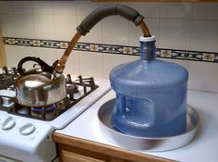
Purifying Water
DISTILLATION. Distillation involves boiling water and then collecting the vapor that condenses back to water.
Distilled water will not include salt, microbes, heavy metals, and most other chemicals.
Notes:
Distillation involves boiling water and then collecting the vapor that condenses back to water. The condensed vapor will not include salt and other impurities. Distillation will remove microbes that resist these methods, and heavy metals, salts and most other chemicals.
This can be a tricky procedure. You need to be careful that you don’t melt something or catch something on fire.
We recommend that you perform more research to develop the technique that works best for you and your household situation.

Slide 24
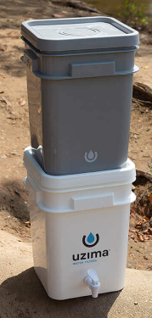
Filtering Water
FILTRATION. Filtration involves running water through a series of filters to remove bacteria and some contaminates.
Some systems filter out anything over 1 micron.
Notes:
There are a number of commercially developed water filters. Many require electricity. We recommend that you acquire a gravity fed filtration system. This will work during a disaster when you don’t have electricity or much of it.
You will want to pre-filter out large organic material before running it through a water filter. This will delay any clogging and allow the filter to filter many more gallons of water.

Slide 25
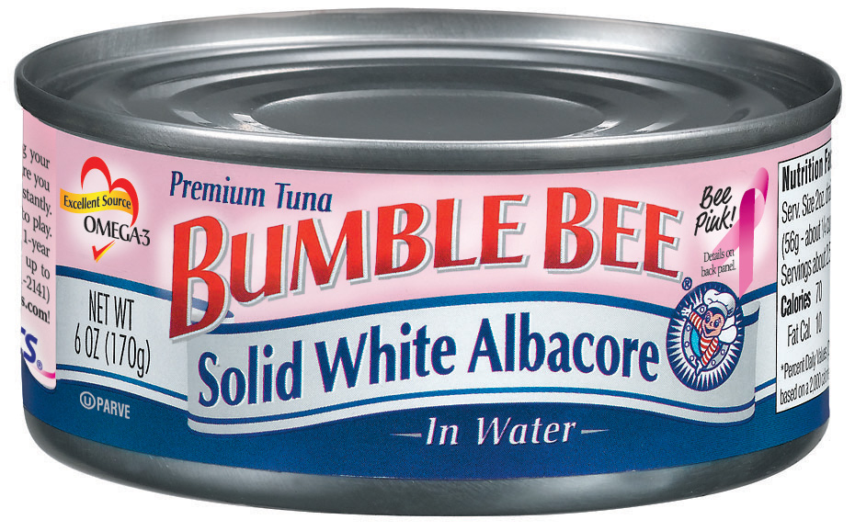
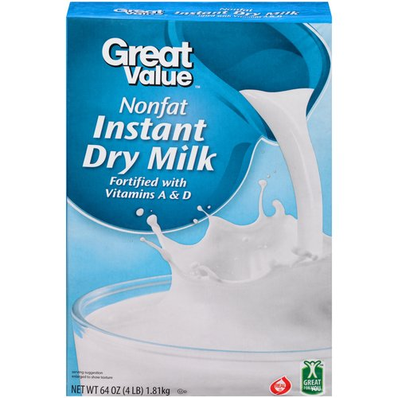
Food
Buy food that your family will like.
Store canned foods, dry mixes and other staples.
Purchase a few extra items each week and place the extras in a secondary pantry.
Notes:
Buy food that your family will like. In fact, familiar foods are important. They can lift morale and give a feeling of security in time of stress.
Store canned foods, dry mixes and other staples. Canned foods won’t require cooking, water or special preparation.
Purchase a few extra items each week and place the extras in a secondary pantry.
Every so often, purchase a box of powdered milk and put in in your pantry. Remember to use the oldest food first. When you purchase new items, put them on the shelf in the back of the older items.
Have a couple of manual can openers on hand!
Determine how much your family eats of given food items and start purchasing a couple extra items each week. You want to slowly build up your food stockpile. This spreads the cost out and ensures that everything doesn’t expire at the same time.

Slide 26
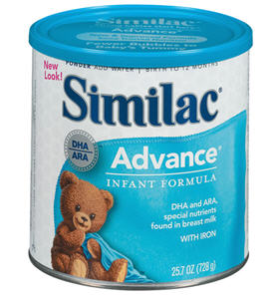
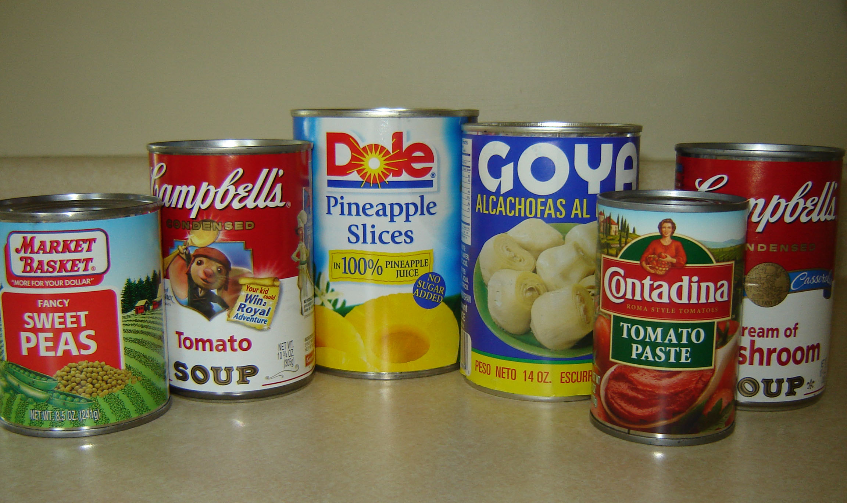
Food
Include foods that are high in calories and nutrition.
Include foods that require no refrigeration and easy preparation.
And remember the littles ones!
Notes:
As you stock food, include foods that are also high in calories and nutrition. Foods that require no refrigeration, preparation or cooking are best.
Individuals with special diets and allergies will need particular attention, as will babies, toddlers and elderly people. Nursing mothers may need liquid formula, in case they are unable to nurse. Canned dietetic foods, juices and soups may be helpful for ill or elderly people.
Don’t forget the family pets!

