Slide 1
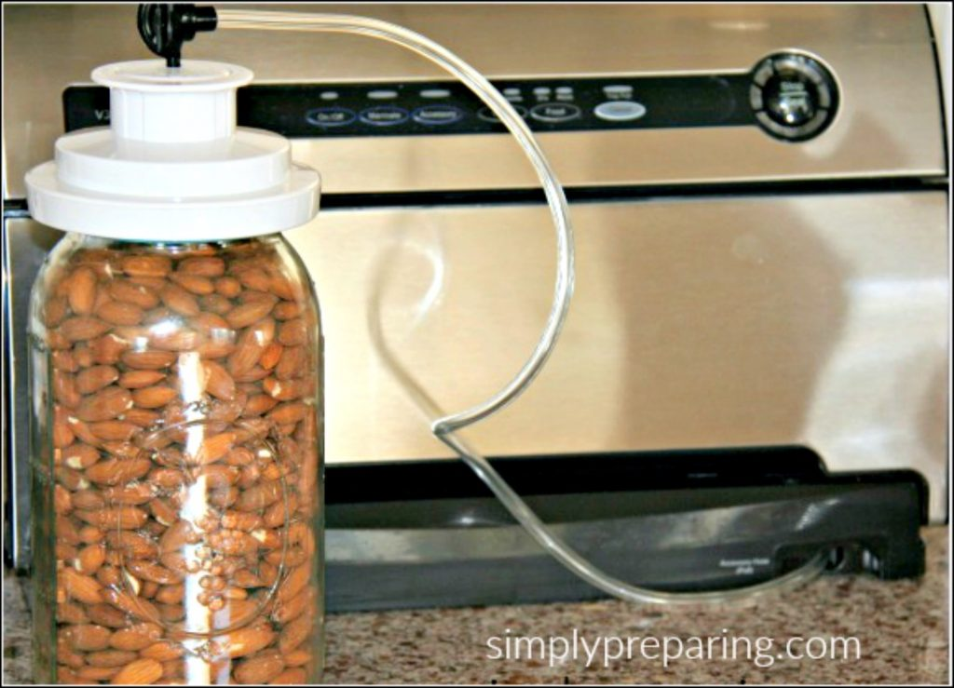
Food
Learn the various ways to store food long term.
Home Canning
Freeze Drying
Dehydrated Food
Vacuum Sealing & Oxygen Absorbers
Consider buying in bulk and repackaging into smaller containers.
Notes:
Purchase dry or canned foods that your family will eat. Even better, can your own homegrown food!
Dry goods can be vacuumed sealed in canning jars, mylar bags, or plastic bags that are made for specific vacuum sealers. Install an oxygen absorber for real long shelf life.
Buying in bulk at a bulk food store can save a lot of money on some products. Oatmeal can be bought in very large containers which work out to $0.05/serving. However, to make sure the oatmeal lasts longer in the pantry, consider sealing smaller quantities in mylar bags or canning jars.
National Center for Home Food Preservation - https://nchfp.uga.edu/

Slide 2
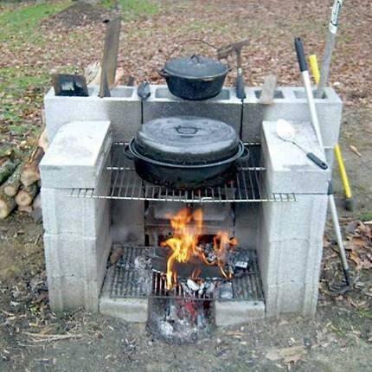
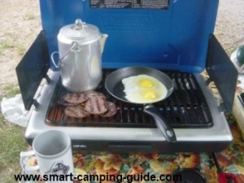
Cooking safely without electricity
Propane and wood cook stoves
Camping Stoves and Bar-B-Que Grills – outside only!
Woodstove tops
Sternos
Outdoor fireplaces
Notes:
Never operate camping stoves and bar-b-ques indoors. Carbon monoxide can be emitted from these appliances. In an enclosed space, this can be deadly.
Of course, if you are planning on cooking inside on or in a woodstove or outdoors on a fireplace, you’ll need a good stock of seasoned firewood.

Slide 3
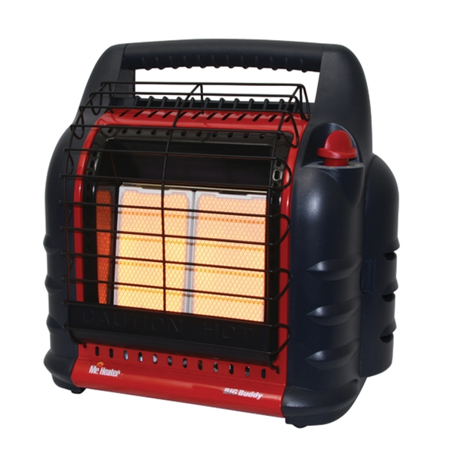
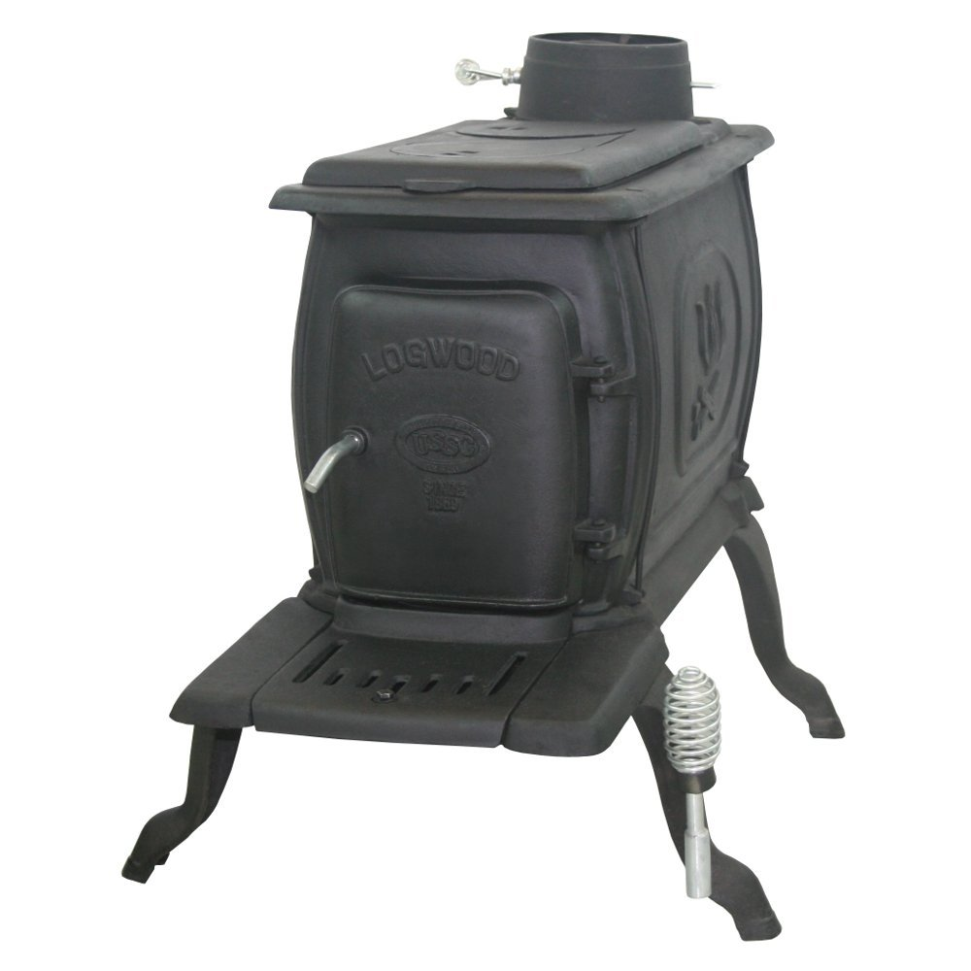
Heating Your Home
Wood Stoves
Non-Electric pellet stoves
Non-Electric wall-mounted vented propane heaters
Portable Propane Heaters
Portable kerosene convention heaters
Take care to allow fresh air to enter room and to have a battery-operated CO monitor
Notes:
Heating your home without electricity, unless you already do, may be a long-term investment. Well before a disaster event, plan out how you plan on heating your home during a power outage. Research it extensively to ensure that you do not damage your home or kill your family with CO fumes.
You will also need to plan out and stockpile your fuel source, whether it is seasoned firewood, propane bottles or wood pellets.

Slide 4
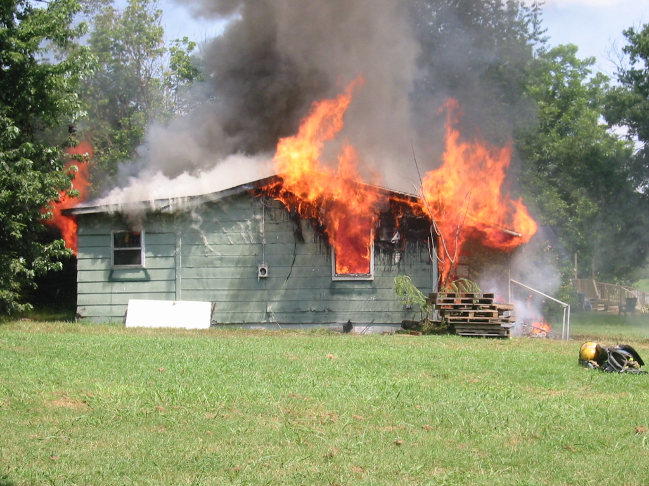
Staying Warm
During Disasters, too many people have either burned their homes down or poisoned themselves with carbon monoxide. You need to plan how to stay warm in your home safety.
Notes:
Know what you are doing. During a disaster, too many people try to jury-rig up something they are not very familiar with. This usually ends very badly.

Slide 5
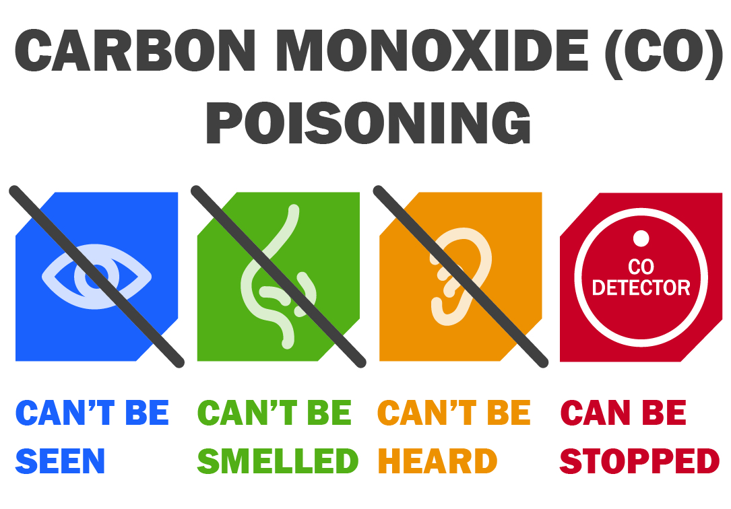
Carbon Monoxide (co) poisoning
CO is colorless and odorless and can kill quickly.
Found in fumes produced any time you burn fuel in cars, small engines, stoves, lanterns, grills, fireplaces, gas ranges, or furnaces.
CO can build up indoors and poison people and animals who breathe it.
Notes:
The number one killer during many Winter and Ice Storms is carbon monoxide poisoning.
The most common symptoms of carbon monoxide (CO) poisoning are headache, dizziness, weakness, upset stomach, vomiting, chest pain, and confusion. CO symptoms are often described as “flu-like.”
If you breathe in a lot of CO, it can cause unconsciousness or death. People who are sleeping or drunk can die from CO poisoning before they have symptoms.
We recommend that you have a battery-operated carbon monoxide detector in your home.

Slide 6
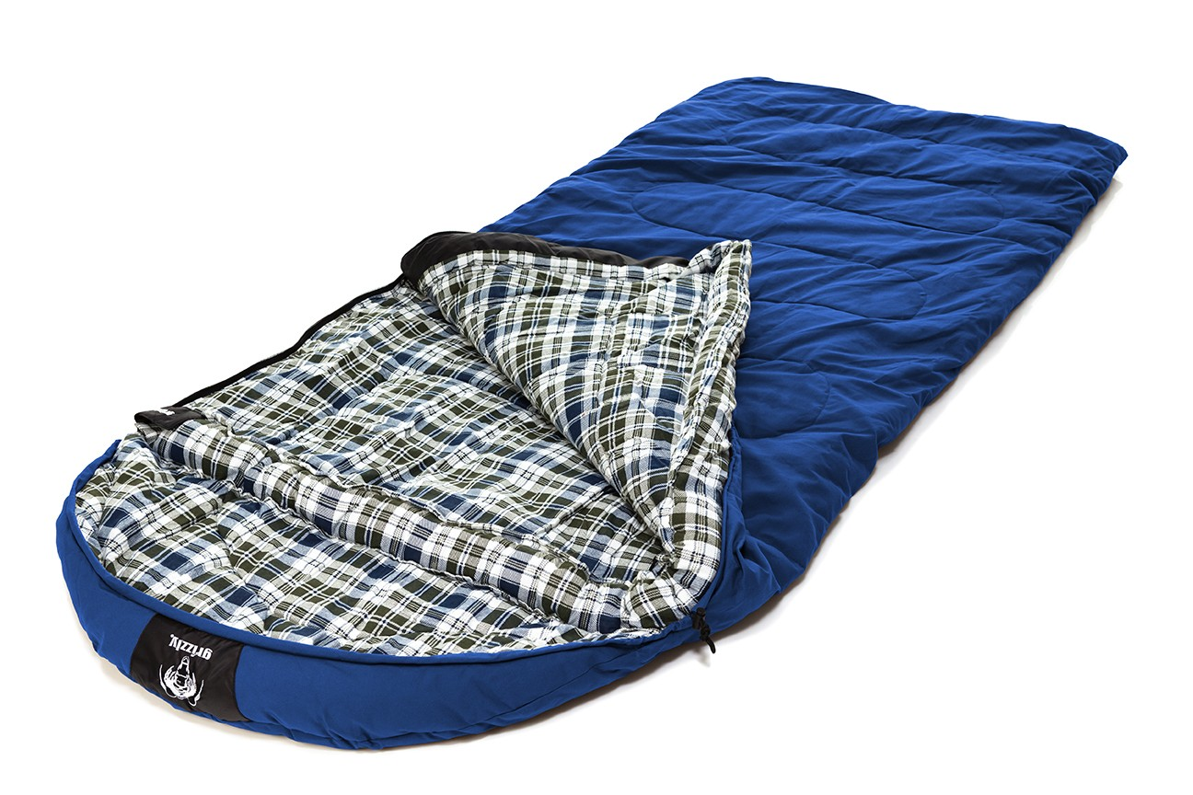
Staying Warm
Close off rooms you do not need to heat
Wear layered clothing
Use sleeping bags and warm blankets
Set up and stay inside a tent in your living room
Stay hydrated
Notes:
There is no sense in trying to keep the entire house warm (unless you have a wood stove that can heat the whole house) with your disaster expedient heat source.
Close off all rooms that you do not need, and only heat the room(s) that you need, such as a single bedroom and connected bathroom. This will greatly reduce your heat load.
And remember to be drinking all that water you stored. (You may want to move the water to the area of the house that is being heated, so that it doesn’t freeze).

Slide 7
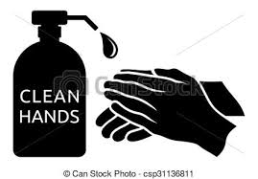
Sanitation
The number one killer in history is poor sanitation. Don’t let it claim you during a disaster.
Good basic personal hygiene and handwashing are critical to help prevent the spread of illness and disease.
Notes:
Hygiene is especially important in a disaster.
Clean, safe water is essential for proper hygiene and handwashing.
It may be difficult to stay clean during a disaster, but it is very important. Use clean dishes. Wash your hands. Be sanitary.
During a disaster, you do not want to get sick.

Slide 8
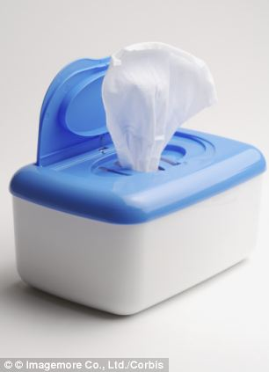
Washing
Alcohol based hand sanitizer.
Sponge bath with a basin of “clean” outside water, like rainwater
Baby wipes.
Notes:
If you can not shower or bath then take a sponge (or washcloth) bath. Use a basin of “clean” outside water.
Baby wipes provide the cleaning agents, a refreshing feel and also remove dirt as well. A quick wipe down of all the important parts can keep you happier and healthier.
Alcohol based hand sanitizer is good for killing germs on hands. Don’t take a bath using hand sanitizer though!

Slide 9
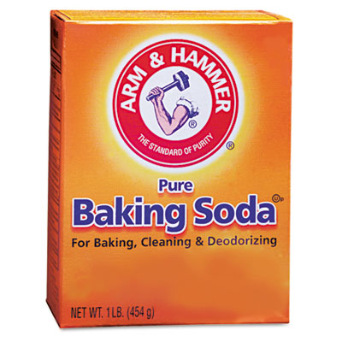
Keeping Teeth Clean
Have a good stock of toothpaste, tooth-brushes, and mouthwash
While water is short, you can brush your teeth like normal but rinse with mouthwash.
In a pinch, baking soda can be used in place of toothpaste.
Notes:
Have a good stock of toothpaste, tooth-brushes, and mouthwash.
While water is short, you can brush your teeth like normal but rinse with mouthwash. This will keep your mouth clean and reduce water required.
In a pinch, baking soda can be used in place of toothpaste.

Slide 10
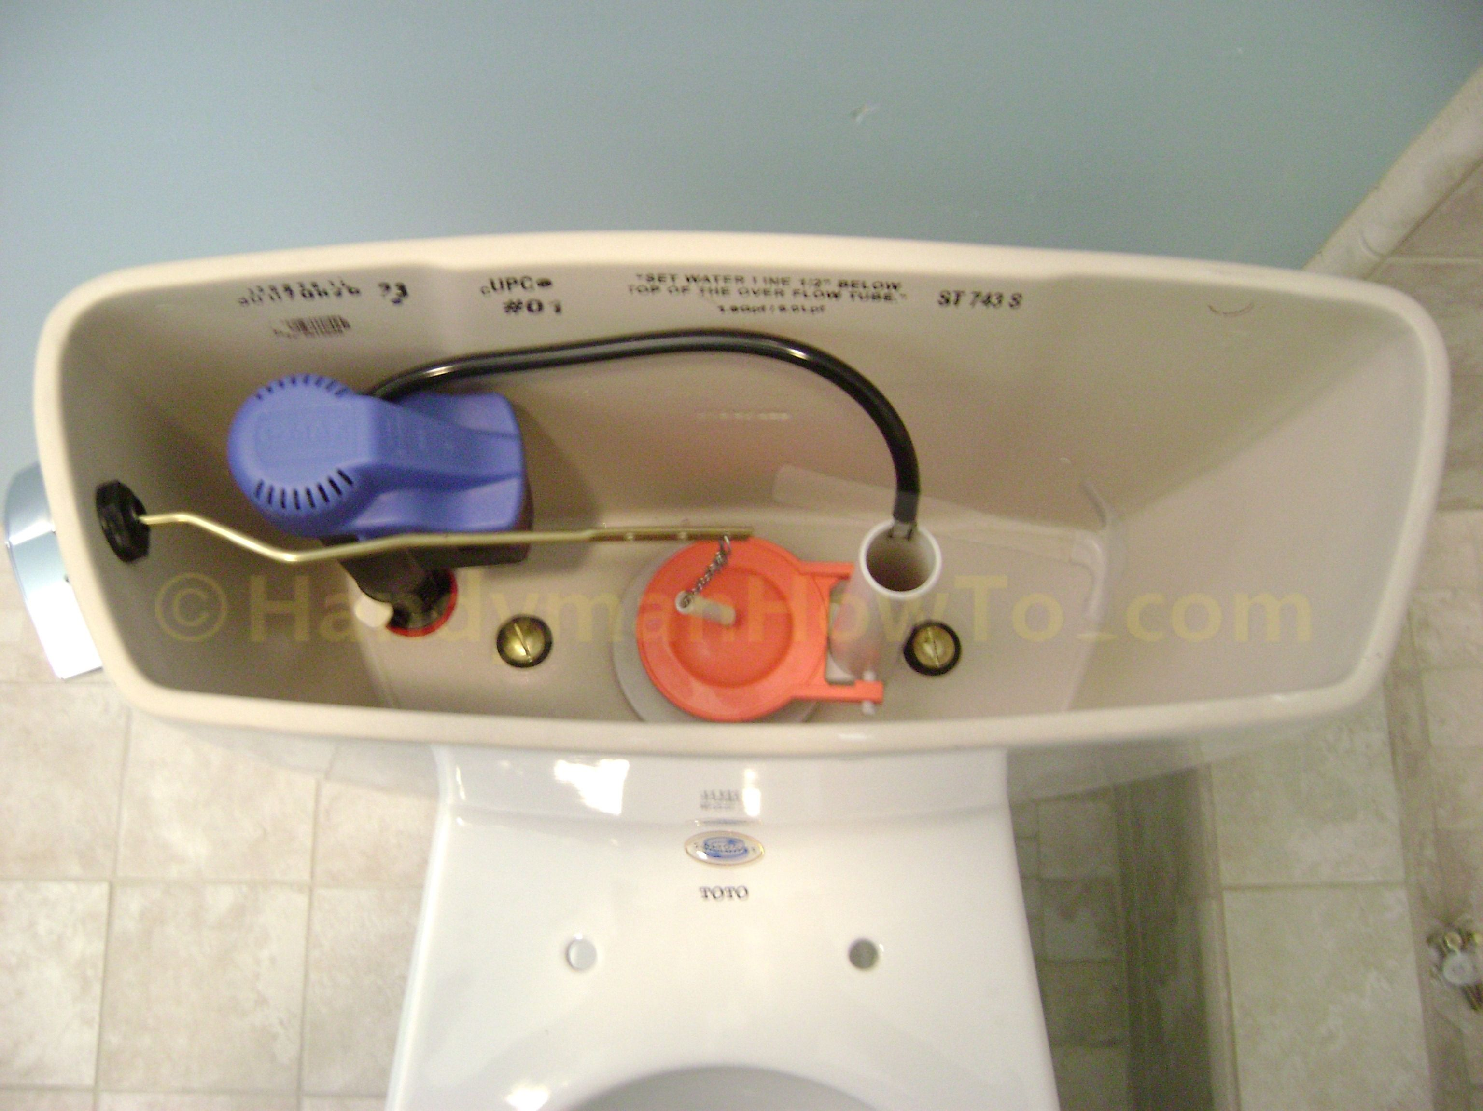
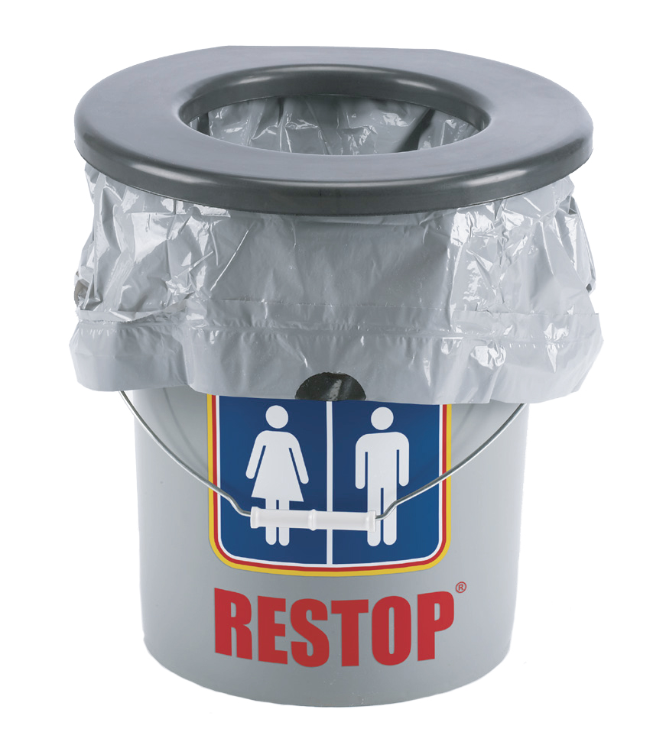
Toilet
Some ideas for disaster toilets include:
Manually fill the tank on the back of toilet with non-potable water.
Line the toilet bowl with a trash bag.
Use a 5-gallon bucket with camp toilet seat.
Notes:
Use non-potable water from outside to fill the tank on back of toilet. Set a brick or two in the tank to replace some of the water volume.
Use the regular toilet and line it with a trash bag. Duct tape the edges of the bag to the toilet to prevent the bag from coming off. Add kitty litter to absorb liquid and smells. Replace when needed.
The first method is by far the most sanitary and less smelly! However, if you have no available water, try the second method.
Or use a-5 gallon bucket, toilet seat and double line it with trash bags. After leaving a deposit in the bucket add kitty litter or saw dust or wood chips to cover the smell. A small amount of bleach could also be added if desired. Replace the trash bags often. (You might want to double bag the bucket.
This toilet idea will cost about $20 and the materials can be found at Walmart. Look for the toilet top in the camping section. The 5-gallon bucket can be found in the paint section.

Slide 11
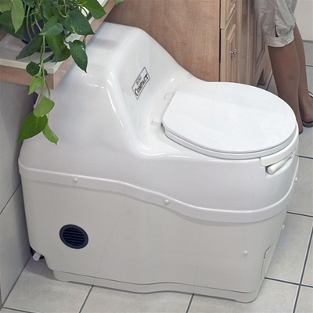
Toilet
A composting toilet uses no power or water.
Notes:
A composting toilet uses no power or water to start with and could be a great asset during a power outage, as it would be one less thing to worry about. The idea is to separate liquid from the solid, compost the solid and use as fertilizer.
If you are planning on a composting toilet, this is a permanent solution. This is not something you roll out for a disaster. This can be expensive to set up. If you already have a conventional gravity fed septic tank and leach field system, its best to stay with that. However, if you are building a new home, that would be the time to add the composting toilet.

Slide 12
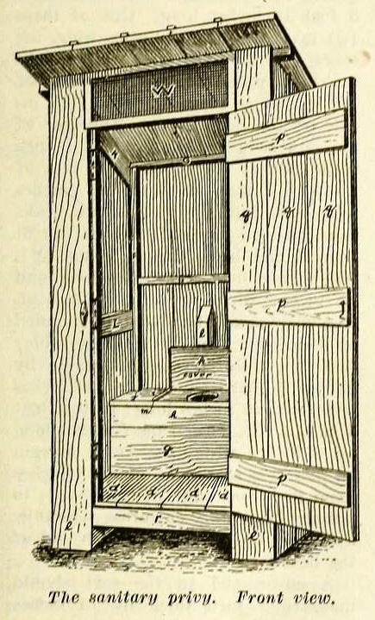
An old-fashioned Toilet – The Privy
Build an outhouse (Privy). This of course would need to be in place before the ground freezes.
Many communities or states require a plumbing permit even though its not connected to your plumbing.
Notes:
This is what we had before indoor plumbing and it still exists today at remote camps.
Just be aware that the hole needs to be of a certain size and the soil stable (so that it doesn’t collapse under the outhouse). You should have some lime on hand to help keep it fresh and sanitary.
https://www.uaf.edu/ces/publications/database/housing/outhouses-alaska.php
https://www.youtube.com/watch?v=N86gfJzOEJg

Slide 13
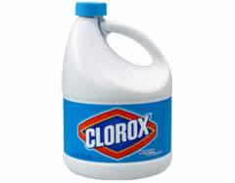
Kitchen sanitation
Bleach is the greatest cleaner and killer of all things nasty.
Liquid bleach does lose its effect over time
Concentrated bleach granules.
Bleach wipes.
Notes:
It is very important that kitchen surfaces be kept very clean and sanitary. During a disaster, medical services may not be available and pharmacies may not be open. Getting sick during a disaster can may matters far worse.
While liquid bleach does expire and lose its effect over time, there are also concentrated bleach granules that store more compactly. Then you can "make" bleach by diluting in water.
Making Bleach Solution from Dry Bleach Powder (Jay Whimpey, of The American Civil Defense Association)
Place one gallon of clean water in a clean plastic container. A jug previously used for a 6% bleach solution is ideal since it is already marked.
Pour one cup of water out of the container to make sure there is room for the dry bleach powder or granules in the container.
Pour one and 4/10ths of a cup of bleach granules into the container, seal the container, and gently agitate to help the granules mix and dissolve in the water.
Allow the granules several hours to completely dissolve and then the bleach solution can be used to disinfect the water using instructions for 6% bleach solutions.
Smaller amounts of liquid bleach can be mixed by simply using the same ratio. For example, one quart of bleach solution can be prepared by using one quart of water and 0.35 cups of dry bleach powder. A one-third cup measure would work great. This does not have to be precise since there is a chance to add more to the water being disinfected in the final treatment step.
**WARNING: This is a concentrated bleach solution not to be consumed directly!**

Slide 14
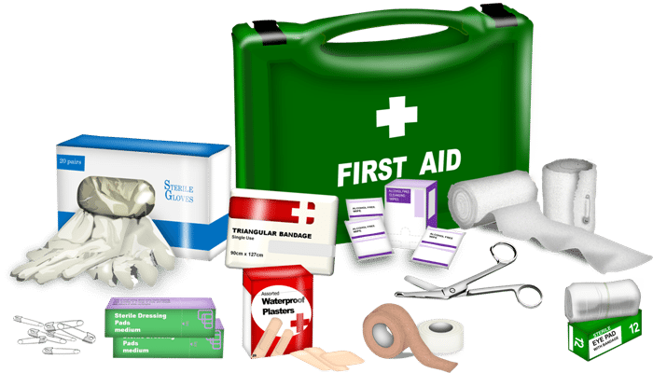
Medical Needs
The likelihood of injuries during a disaster is high.
Have a well-stocked first aid kit.
Train all family members, even children, in basic first aid.
Your family’s life will be dependent on what you do.
Notes:
This is a good idea even when there is no disaster. Everyone in your family should know basic first aid, even the kids. First aid for children will be very basic. Purchase a good First Aid Handbook. The American Red Cross, American Medical Association and the Boy Scouts of America all have good reference books.
Even if emergency medical services are available, it could be hours before they can reach you. Bleeding to death simply because you don’t know bleeding control, isn’t tragic, it’s stupid.
Most commercially produced family first aid kits have very basic medical supplies. There is nothing in there for broken bones or several bleeding. Consider adding tourniquets, splints, large bandages and other items for major injuries.
Firefighters and EMTs may want to invest their own EMS jump kit for home use.

