Slide 1
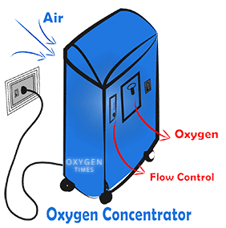
Special Medical Needs
Electrical-dependent medical devices
Speak with your family, medical provider and the supplier of your electrical dependent medical equipment before an emergency event occurs. Waiting until a disaster occurs and the lights go out is too late.
Extra batteries or oxygen bottle is a short-term solution, only.
Notes:
There are too many people who rely on electricity for medical reasons who have no plans for what they are going to do when the lights go out.
If you are someone who relies on an electrical-dependent medical device (EDMD), you must have your own plan on what you are going to do!
You should speak with your family, medical provider and the supplier of your electrical dependent medical equipment before an emergency event occurs. Waiting until a disaster occurs, and the lights go out is too late.
If you do not have backup power, have a plan on where you are going to go and how you are going to get there. Do not rely on the government to provide emergency shelters, it may not happen.
If you have a family member with an EDMD who lives elsewhere, ensure that your family member has a plan. If you know a neighbor with an EDMD, reach out to them and help them to develop a plan.
Now, before the lights go out.

Slide 2
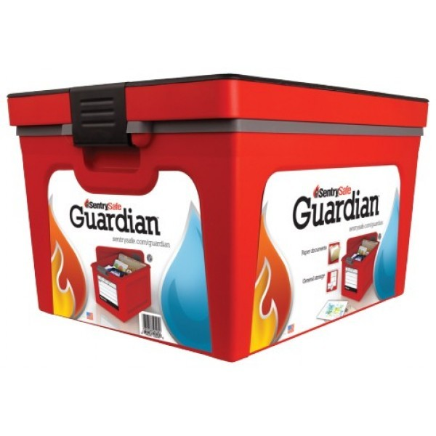
Important Records to safeguard
Inventory and take pictures of all your personal property.
This will be very important when filing insurance claims.
Keep of all your important documents safe.
Acquire a fireproof and waterproof container to store these important documents.
Notes:
A fireproof container will cost you $30-60. However, saving your important documents will be priceless and will save you countless hours of aggravation.
Not documenting all your personal property and having proof that it existed before a disaster may costs you tens of thousands of dollars in lost insurance claims.
Start by taking photographs of every room in your home, from all four directions. Then as you have time, document everything that you would want to replace one room at a time.

Slide 3
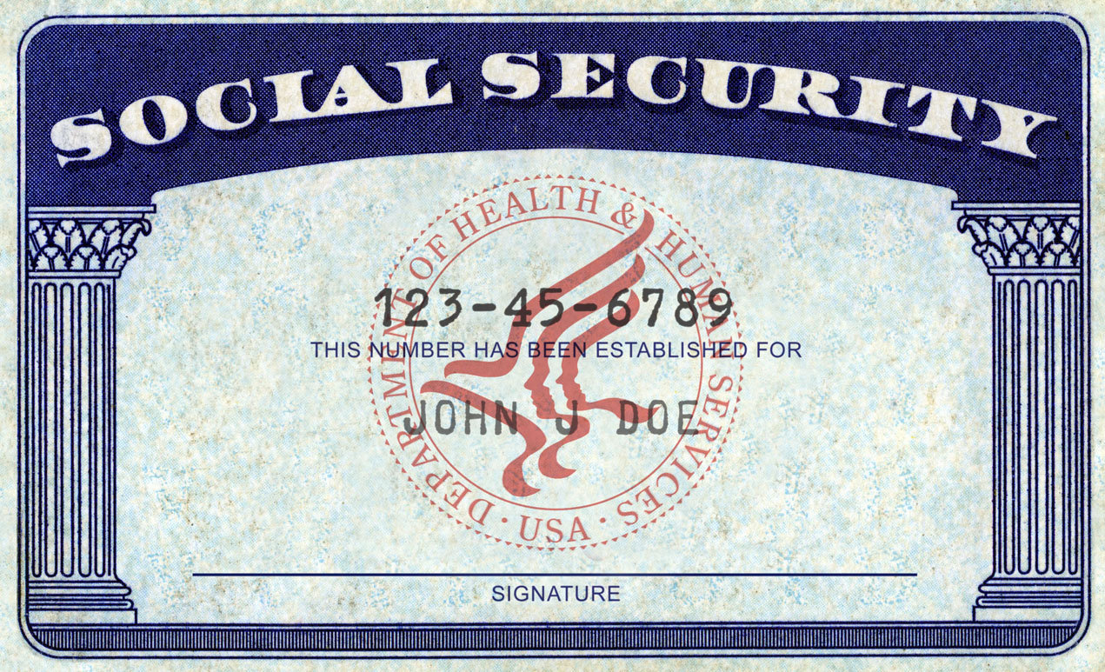
Important Records to safeguard
Household inventory
Property records, deeds, titles & leases
Personal Wills & Powers of Attorney
Automobile titles & copy of registration
Marriage, Birth and Death Certificates
Social Security Cards
Important receipts and bills of sale
Insurance policies
Military Service Records
Adoption Papers
Notes:
Record all of your major “stuff”. Include make, model and serial numbers.
Take pictures of every room, from every angle. This will display a lot of what you have.
Once you have built your list, every time you purchase something you would want replaced, add it to your household inventory list.

Slide 4
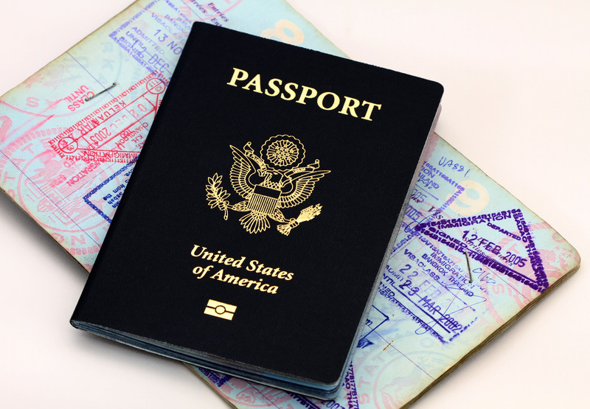
Important Records to safeguard
Passports & Citizenship papers
Income Tax Returns
Educational Records
Extra cash and credit card numbers
Extra house and car keys
Immunization Records
Bank records and accounts numbers
Address List of important numbers
Copy of your Driver's licenses
Notes:
We recommend that you have at least 2%-10% of your take-home salary in cash at home in preparation for a disaster. Keep small bills that can be used to buy the things you need when the power is out.
Some may worry about the loss of interest in keeping money at home instead of in a saving account. An average savings account today bears an annual yield of 0.08%. If you are keeping $1,000 home instead of the bank, you have lost $0.80 in annual interest. 80 cents won’t pay for the gas to get you to and back from an ATM (even if it was working).

Slide 5
Disaster Prepare your finances
During an extended power outage, banks will be closed and ATM machines will be inoperative.
Have cash on hand in small bills.
Minimum – safely store a few hundred dollars.
Pay off debt.
High interest debt first – credit cards
Mortgage second – if you lose your job(s), don’t be in a situation where you lose your home for non-payment
Notes:
If ATMs are not working and the credit card readers aren’t functioning at retail establishments, you will not be able to make purchases. However, they may still be able to take cash.
At a minimum, have a few hundred dollars on hand at home in your fireproof container. If you can gradually build it up, we recommend having at least 1-2 months of salary on hand.
The interest you will “loose” by not having in in the bank is pennies. The annual interest on $1,000 is $0.80.
Paying off your home and having it insured are the two best things you can do to prepare for a disaster.
If you lose your job or the country suffers a major financial crisis, you won’t lose your home to the bank.

Slide 6
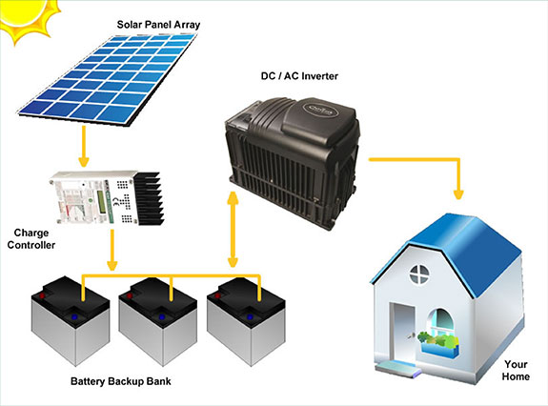
Backup Power Options
Gasoline/Propane Electrical Generators
Solar Powered Generator
Wind/Solar Power and battery storage system
Deep Cycle Batteries and Transformers
Notes:
Generators are great for proving backup power for the short term – a few hours up to a few weeks. However, it can cost 5 to 7 times as much to generate your own electricity with a generator then it costs for power from the electric company. It may also be difficult to acquire additional fuel during a disaster.
You may consider, only running your generator for a few hours a day. If you run the generator for 6 hours/day instead of 24 hours, the fuel will last 4 times as long. If you had enough fuel for one week, it will now last one month.
If you can afford it, solar panels and wind power systems that can charge batteries are great. However, these systems can be very expensive and the batteries need to be replaced over time.

Slide 7
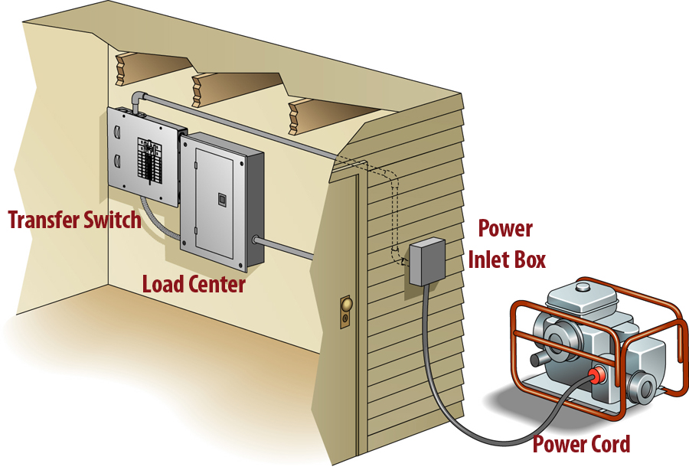
Hooking up a Generator
Running appliances directly off the generator can cause problems with too many things to plug in and with power surges.
Best to run the generator through your electrical panel. Have a licensed electrician hook up a transfer system.
Jury rigging it can burn down your house or electrocute someone outside your home when it “back feeds”.
Notes:
Back feeding the line can be easily done and is very dangerous. Some people have plugged their generator into the laundry dryer outlet and back fed it into the electrical panel. Others wire it directly into their panel. If they do not switch the electrical panel off from commercial, this will feed back into the line outside. Wires that were thought to be de-energized can be re-energized. Line crew and other people have been electrocuted because of this action.
Hooking a generator up to your home panel or through the dryer can also cause surges which can damage appliances and start fires.
Consider it like home insurance; pay a little extra and protect your home and others. Hire a licensed electrician to wire the generator up properly.
There are several ways this can be accomplished. If you have room in your electrical panel, you can use an interlock kit. There are also meter connection kits or a manual transfer switch. Your electrician can tell you what would work best in your situation.

Slide 8
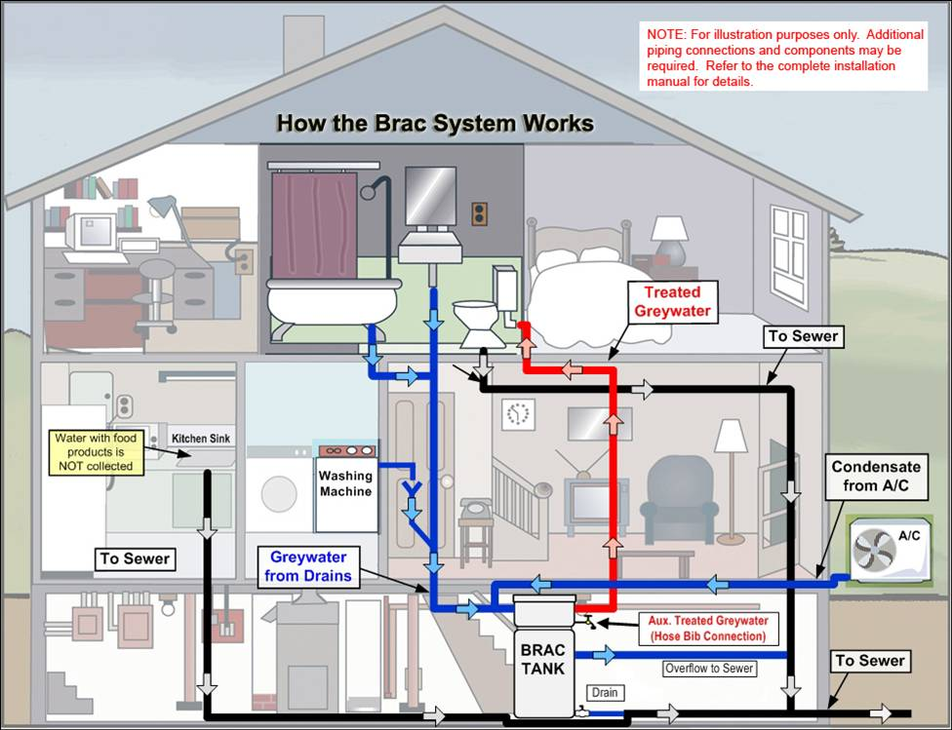
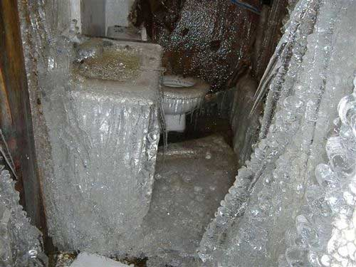
Protecting Plumbing during a winter Time power outage
The number one cause of damage to a house in a wintertime power outage is frozen pipes that thaw out and cause water damage.
And its all preventable!
Notes:
On December 24, 2013, Maine experienced an ice storm that resulted in a region-wide power outage that lasted for 3-4 days. There were several homes in the areas that lost heat and their home up froze and burst the pipes. Then when the power came back on, water filled the house and caused a great deal of damage. One low-income homeowner, who did not have homeowner’s insurance, experienced nearly $40,000 in damage to her home.
The real tragedy was that it is completely unavoidable with a little bit of knowledge.
If you can stop the flow of water into your home, whether by public water supply or through your well pump, and drain the pipes, there will be nothing to freeze and the pipes will not burst.
Shut off the water at the main valve or shut off the well pump breaker.
Drain the pressure tank.
Open all faucets until they drain completely.
Insulate undrainable pipes around their main valves. Use newspaper, blankets or housing insulation.
Drain toilet flush tanks and spray hoses.

Slide 9
Communicating w/ emergency services
While you are at work at the fire or police station, how will your family communicate with emergency services?
One of the most vital needs during an emergency is the need for information.
What’s happening?
What should I do?
When is power returning?
Where can I get help?
How and who do I contact?
Notes:
We have found that people are as hungry for information as they are for food during a disaster.
“When will the power come back on?”
“Where is the nearest shelter?”
“Where can I get assistance?”
“What roads are blocked?”
“Is it safe to drive across the flooded road?”
“Where can we get gasoline?”
“Who is helping?”
“How do I call for help if I have a medical emergency?”
“Can I help?”

Slide 10
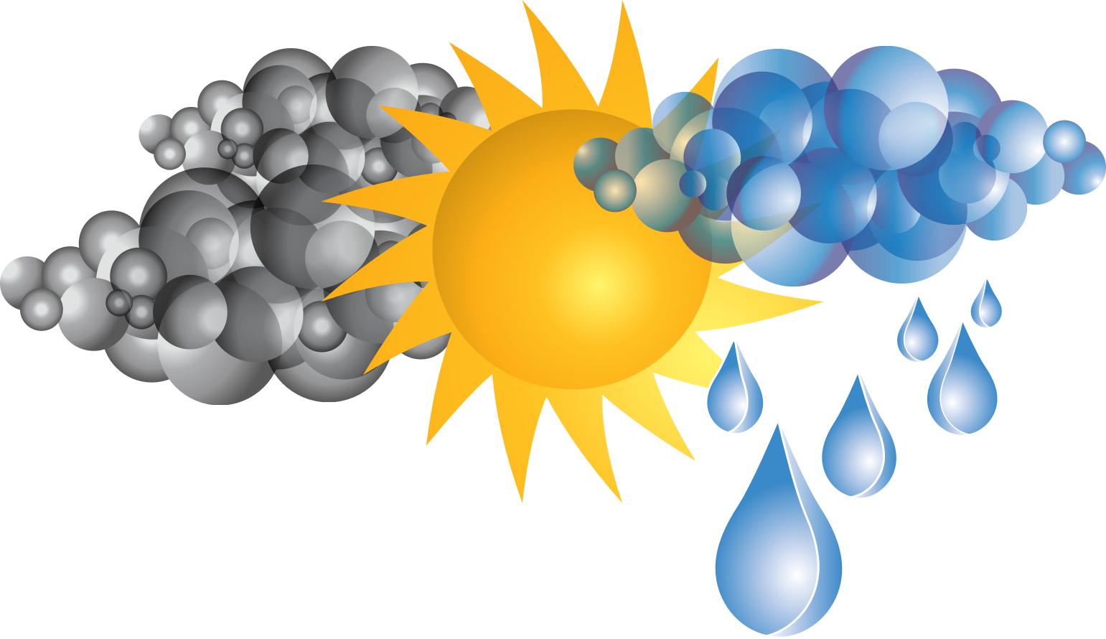
Public Information
Weather forecasts
Power utility status information
Location and open hours of local warming shelters
Location of regional overnight shelters
Locations of mass feeding sites or community points of distribution
Location of major road closures
Evacuations routes.
Instructions to Shelter-In-Place or announce when it is safe to come out
Notes:
Emergency Management will make every effort to provide emergency public information before, during and after a disaster. But you need to help!
Have an off-grid way to receive emergency information. Have a way to recharge your cellphone from a small solar charger. Have a battery-operated, crank or solar AM/FM/NOAA radio available. NOAA maintains the National Weather Service Alert Radio service and will send out emergency information 24/7.

Slide 11
How to find out what’s going on
If you still have power & internet access:
Local Television & Radio Stations
Online News sites
Websites and Social Media
Emergency Text Alerts
Note: Please do not call 911 for information
Notes:
The State and County EMA will put out disaster information over commercial radio and television. They will also utilize social media, websites and text alerts. Don’t make them try to find you when it comes to providing information; tune in or sign up to notification services.
Unless you have a real emergency and need assistance, don’t call 911. During an emergency, the 911 system has been overwhelmed because of people calling to ask questions. 911 needs to be left open for people with emergencies, not for people wondering if the road is blocked or asking when they will get their power back. The 911 center doesn’t know when you will get your power back.

Slide 12
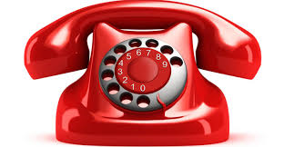
How to find out what’s going on
If you still have telephone access:
Your Town Office, Fire Station or EOC
County Emergency Management
511 (road conditions)
211 (shelter information and disaster assistance)
Reminder: Please do not call 911 for information
Notes:
Some towns will staff the telephones at the Fire Station or Emergency Operations Center (EOC) during a disaster. They will have much better information then the 911 center about what is happening in your town. (Even better, volunteer to staff the phones at the Town fire station for a few hours).
Call 511 if you want to know the condition of state-maintained roads.
Call 211 to find out about assistance that doesn’t involve fire, EMS or law enforcement. If you want to know if there are any shelters open or if financial assistance is available, you can call 211.

Slide 13
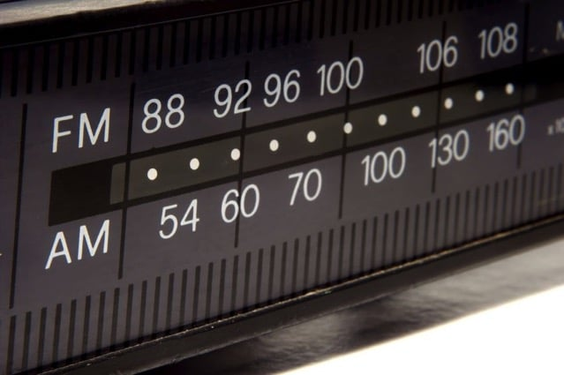
How to find out what’s going on
When you have no power, telephone or internet access, have battery backup solutions:
Battery-operated Public Safety Band Scanner
Local AM/FM Radio Stations
NOAA Weather Alert Radio
Community-run Alert radio stations
Notes:
When you have no electrical power, telephone service or internet service, you can still rely on radio to provide you with updated information.
A NOAA weather alert radio or an AM/FM radio with National Weather Service broadcast channels can be used to find out about the weather situation and emergency information.
Some commercial radio stations will provide air-time for emergency information. We strongly recommend you have a battery-operated AM/FM radio at home that you can use to tune in to emergency information. You can also use the radio in your car (but don’t run the car engine inside an enclosed garage – you’ll generate carbon monoxide which is deadly).

Slide 14
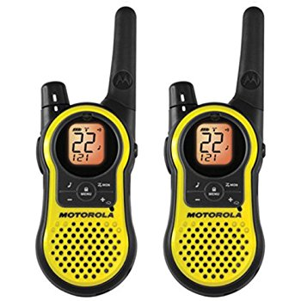
Calling for Help
Call 911, if it is functioning
If 911 is out, can you still call your Fire Station by phone? Is your local exchange still up?
Establish a local radio net with CB, GMRS or FRS radios.
Notes:
Your telephone exchange can be cut off from the rest of the world. You may still be able to call your neighbor, but cannot call 911 or others outside your exchange. Or you may only be able to call long distance.
In a worst-case scenario, all telecomm systems could be out. How will you call for help?
Some communities have installed CB radios or GMRS/FRS radios in their fire stations. Residents with CB or GMRS/FRS radios can call the Fire Station using their radio. If you think this is a great idea, work with your town’s elected officials to build a system or process.
https://www.fcc.gov/wireless/bureau-divisions/mobility-division/general-mobile-radio-service-gmrs
https://www.fcc.gov/wireless/bureau-divisions/mobility-division/family-radio-service-frs
https://www.fcc.gov/wireless/bureau-divisions/mobility-division/citizens-band-radio-service-cbrs

Slide 15
Communicating with Family & Friends
One of the most basic needs during an emergency is to establish contact with your family and friends.
List out all possible ways for you to communicate with your family members. Include contact information.
Identify an Out of Area phone contact
Family Service Radios, GMRS and CB Radios
Amateur (HAM) Radio (need to get an FCC license)
Notes:
Plan out all the various ways you can keep in touch with family and friends during a disaster. Think about what you would do when your normal means of communication is lost.
Sometimes local telephone service can be overwhelmed by local calls during a disaster. In these cases, long distance service may still work. Have a long distance contact that you and other family members can relay information through.
Consider studying and testing for your amateur radio license. This is an excellent way to keep in touch and it is totally in your control.

Slide 16
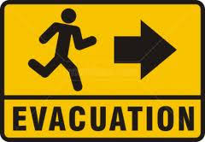
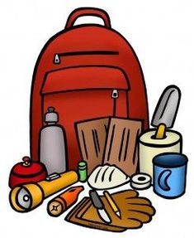
Reasons to Evacuate
Wintertime power outage/loss of heat to home
Hazardous materials release
Approaching forest fire
Damage to your home from a fire, wind or water.
Area flooding
Notes:
Sometimes it just is not safe to stay home and you must evacuate.
Area Flooding
Winter time power outage - Local overnight shelters may be available for up to 1-2 weeks
Hazardous materials release - short term; a few hours at most
Approaching forest fire - Local overnight shelters may be available for up to a week
Damage to your home from a fire, wind or water
Permanent relocation if your house is unliveable
Red Cross helps for a few nights with Hotels
Build and place an emergency kit in your car. Build a “Go-Kit” that you can grab and take with you. Don’t forget to grab your fireproof case with your important documents.
A Go Bag might include:
Snacks, Water Change of clothing, outwear for weather
Flashlight with batteries Medicine, extra glasses
Cash Garbage bag and plastic ties for
First aid kit Moist towelettes, toilet paper
Sleeping bag, pillows Matches in a waterproof container
Toiletry items Maps

Slide 17
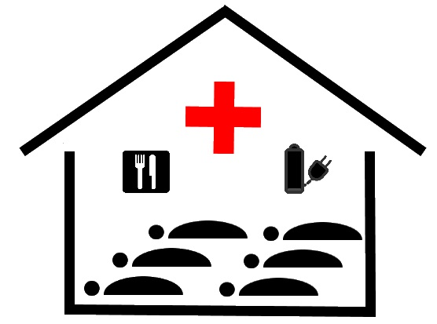
If you go to an overnight shelter
Pillows, sheets, hygiene supplies and other comfort items
Supplies needed for children and infants, such as diapers, formula and toys
Special items for family members who are elderly or disabled
Chargers for any electronic devices you bring with you
Books, games and other ways to entertain your family
Foods that meet unusual dietary requirements
Prescriptions and emergency medications
Important personal documents
Extra clothing
Notes:
If you cannot stay with other family or friends and a hotel is not an option, you may go to an overnight emergency shelter. These are typically operated by the American Red Cross. Though they will provide a cot, blanket and meal, there are other items you will want to bring.
This will not be an enjoyable living experience, but may be your last resort.

Slide 18
Protecting your family
There are bad actors who will show up during disaster events to prey on others.
This can be by scammers or burglars. Desperate burglars may be very violent.
Determine how your family will protect themselves.
Notes:
There are bad actors who will show up during disaster events to prey on others. Some will be scammers, some will steal your property and others will threaten your life. You will need to be prepared for this eventuality.
Number one rule to identify scammers – if it sounds too good to be true – it is too good to be true.
Only hire contractors you know or can get good references on.
During bad times, some people will decide that they want the disaster supplies, or the generator, or the money that you have. The telephone may not be operative. You will want to have a self-defense plan.
When seconds count, the police are minutes or hours away. During a disaster, they may simply not be able to come to your assistance.
For those willing to do you harm, have a self-defense plan.

Slide 19
Checking in on family & Neighbors
Check up on the safety and wellbeing of family members who are separated from you.
Check up on your neighbors, especially if they are elderly or have young children.
There simply is not enough public safety personnel to check up on all residents.
Notes:
There is no government agency that checks up on the status of individual citizens. You need to check up on family members who are not living with you. Also, check up on your neighbors to see how they are doing.
During Superstorm Sandy, the City of New York had to bring in national guard and forestry personnel from pother states to go door to door to check on residents. They found many people who were sick, injured and dehydrated. If New York City does not have enough responders, it is a pretty good chance that your community doesn’t have enough responders.

Slide 20
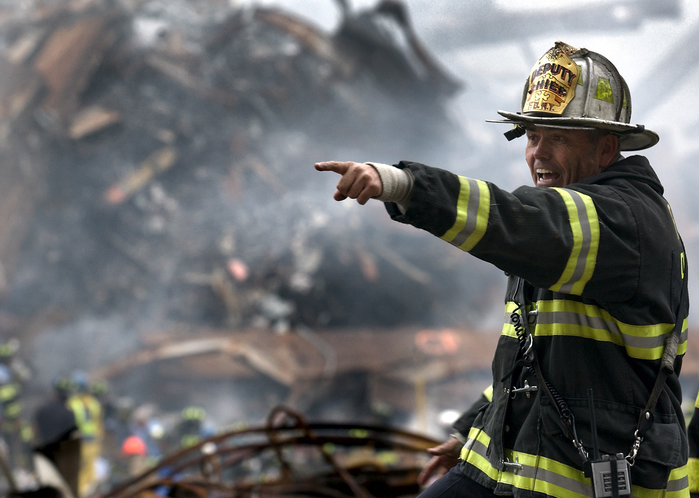
Working during a disaster
Your actions serving your community as an emergency responder during a disaster is vital for your community to recover.
Its tough to leave your family during a disaster, but your family will suffer longer if your community takes longer to recover.
Therefore, make sure your family is prepared at home so you can go to work!
Notes:
As an emergency responder you know that bad things happen to people. You respond every day to families impacted by fires, medical issues, accident, and crime. Don’t fall into a trap thinking that bad things can’t happen to you and your family or that you will not be impacted by a major disaster.
Therefore, prepare your family for now before the hurricane, earthquake, wildfire, flood, or a grid failure from a severe solar storm, high-altitude electromagnetic pulse or cybernetic attack.
Consider forming a neighborhood preparedness group to share home spaces, food, water, communications and security. Use the information in this class to prepare your family for disaster.
When you know they are ready, you will have the confidence to be able to go to work. As an Emergency Responder, you must be on the job savings lives and property in order to help your community recover.

Slide 21
Disaster Preparedness
Don’t be a victim or a liability.
Get Disaster Prepared.

